Slide 1
Cell Recap

Slide 2
Handouts and or textbook
What is the cell theory?
What are cells?
How has the theory changed?
What are the similarities and differences between plant and animal cells
Unicellular vs. multicellular
Where do cells come from? Explain the process and whats going on during each phase in your own words
Notes:
http://gtm-media-2.discoveryeducation.com/v2.3/techbookpdfs/DE_G6-8_CellTheory_GTK.pdf
http://gtm-media.discoveryeducation.com/videos/dsc/data/DE_DiscoveryofCellsandCellTheory_G6-8_FINAL.pdf

Slide 3
Questions you should be able to answer by the end of the video…
Why are cells important? (1:50)
How are new cells formed?
How do cells in single-celled and multi-cellular organisms differ? (9:16)
What are the main characteristics of cells? (1:21)
Notes:
http://tools.discoveryeducation.com/assignment/viewAssignment.cfm?guidAssetId=53ACAA43-126E-4054-A48A-477F2BF9D711&assetGuid=53ACAA43-126E-4054-A48A-477F2BF9D711&blnPopup=1&strEditCopy=Copy&blnPlayer=1

Slide 4
Photosynthesis
The process in which light energy, carbon dioxide, and water undergo a chemical reaction to produce glucose and oxygen. Occurs in chloroplast.
Energy + CO₂ + H₂O → C₆H₁₂O₆ + O₂

Slide 5
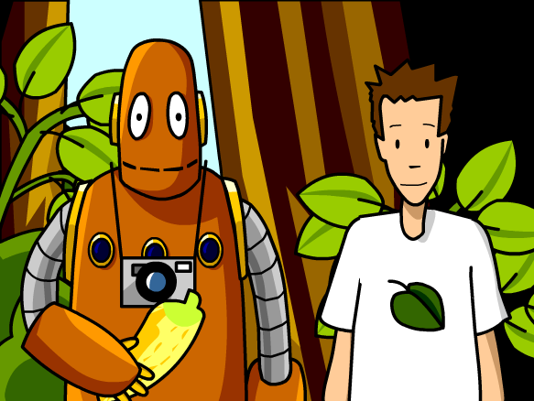
Brain Pop – Photosynthesis

Slide 6
Cellular Respiration
The process in which glucose and oxygen undergo a chemical reaction to produce energy, carbon dioxide, and water.
Occurs in mitochondria.
C₆H₁₂O₆ + O₂ → Energy + CO₂ + H₂O

Slide 7
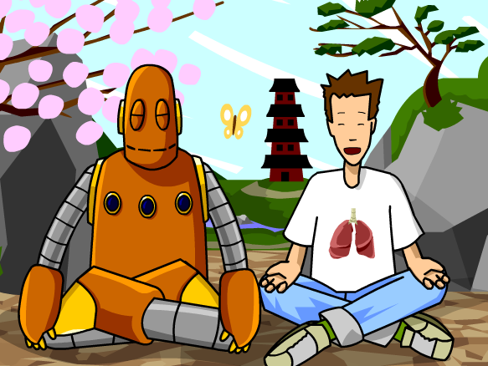
Brain Pop – Cellular Respiration

Slide 8
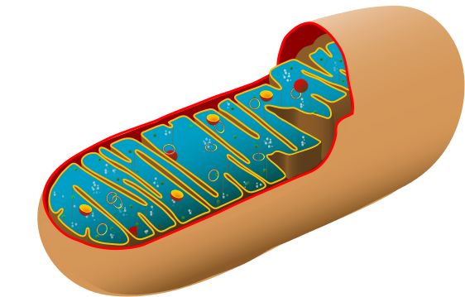
*
Light energy
Plant cell (chloroplast)
Photosynthesis
Glucose
+ O₂
H₂O
+ CO₂
Animal cell
(mitochondria)
Energy
Cellular Respiration

Slide 9
Ticket out the door
Explain how all living things are dependent on cells

