Slide 1
Density

Slide 2
Density is the relationship between an object’s volume and its mass.
Volume is
the amount of space an object takes up.
Volume is measured in
cubic centimeters (cm³) or milliliters (mL)

Slide 3
Mass is the measurement of how much “stuff” is in an object, sort of like weight
Mass is measured in grams

Slide 4
Take a look at the two boxes below. Each box has the same volume. If each ball has the same mass, which box would weigh more? Why?
Take a look at the two boxes below. Each box has the same volume. If each ball has the same mass, which box would weigh more? Why?
Take a look at the two boxes below. Each box has the same volume. If each ball has the same mass, which box would weigh more? Why?
Take a look at the two boxes below. Each box has the same volume. If each ball has the same mass, which box would weigh more? Why?

Slide 5
This box weighs more because it has more mass per volume
More mass inside of its volume
This property is called density

Slide 6
What is density?
Density is a measure of how much matter (objects that take up space) is compacted in an area.
What is the formula?
Density = mass or mass ÷ volume.
volume
Units for density: g or g
cm³ mL

Slide 7
Density can tell you:
How close the atoms or molecules are to each other
More than “heaviness” - density includes how much space an object takes up!!
All substances have density including liquids, solids, and gases

Slide 8
Which one has a greater Matter? Volume? density?

Slide 9
Which one has a greater Matter? Volume? density? How do you know

Slide 10
Density of pure water
Density of pure water = 1.0 g/cm³
If an object has a density greater the 1.0 g/cm³ it will sink in water.
If an object has a density less than 1.0 g/cm³ it will float in water.

Slide 11
Quick Question?
A object weighs 0.99 g/cm³ will this object sink or float? How do you know?
In order to calculate the density of an object we need to know the objects ______ and ________

Slide 12
Sample size of density
If you break a piece off of an object. ..Will it have a different density than the whole piece?
NOOOOOOO!!! Density is based on total mass divided by total volume. When one changes, the other also changes, so the density stays the same!!!

Slide 13
Quick Question?
If I increase volume what happens to density?
If I decrease volume what happens to density?
If I increase mass what happens to density?
If I decrease mass what happens to density?
Notes:
D, I,I, D

Slide 14
How do you calculate density?
Density = mass
volume

Slide 15
The DENSITY TRIANGLE!
M
÷
D
V
X

Slide 16
Example
If the mass of an object is 144 g and it’s volume is 4 mL, what is it’s DENSITY?
144 g
M
4 mL
144 g
÷
D
V
4 mL

Slide 17
Density Equation Trick
A piece of wood has a mass of 18 grams and a volume of 30 cm3. What is the density of the wood? Will it float?

Slide 18
A small rock has a density of 1.4 g/cm3 and a mass of 70 grams. What is its volume? Will it Float? What part of the equation tells if it will or won’t?

Slide 19
Equation | Mass | Volume | Density | Sink/Float
 | 12 g | 0.5 cm³
 | 16 g |  | 0.2 g/cm³
 |  | 5 cm³ | 20 g/cm³
 | 0.9 g |  | 0.3 g/cm³
 | 6 g | 4 cm³
 | 8 g | 1.8 cm³
 |  | 13 cm³ | 9 g/cm³
 | 14.7 g | 15 cm³
 |  | 2 cm³ | 1.1 g/cm³
 | 17g |  | 3 g/cm³

Slide 20
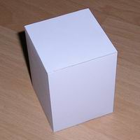
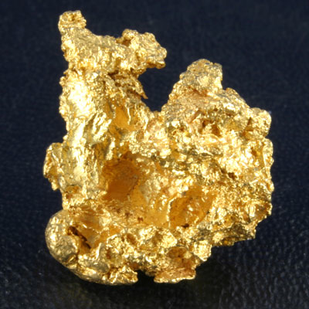
Volume and displacement
How do we find the volume of the figure on the left?
What about the one on the right?

Slide 21
Measuring volume…
Length X Width X Height
Start with a known volume place the irregular shape in and record the difference.

Slide 22
Volume displacement
A solid displaces a matching volume of water when the solid is placed in water.

Slide 23
Let’s Practice…
What is the density (g/cm³) of 48 g of a metal if the metal raises the level of water in a graduated cylinder from 25 mL to 33 mL?
1) 0.2 g/ cm³ 2) 6 g/m³ 3) 252 g/cm³

