Slide 1
Elements, Compounds, and Mixtures

Slide 2
Objectives
8.P.1.1
8.P.1.2
I can:
Define all new vocabulary terms: element, pure substance, metal, nonmetal, metalloid.
Describe the characteristics of elements, and give examples.
Classify elements as metals, nonmetals, or metalloids.
Distinguish between metals, nonmetals, and metalloids.

Slide 3
Elements
A substance that cannot be separated or broken down into simpler substances.
Pure substance – only has one type of particle (atoms).
Every atom in a piece of gold is the same, no matter where it is found.
Every atom of iron is the same
spoon, steel rod, meteorite
Elements are found on the periodic table
111 elements known

Slide 5
Properties of Elements
Characteristic properties – do not depend on the amt. of the element present.
Boiling point, melting pt., density, reactivity with acid, color, hardness, flammability
Can be used to identify elements
Identified by their physical and chemical properties
Categorized by similar properties
Metals, nonmetals, or metalloids

Slide 6
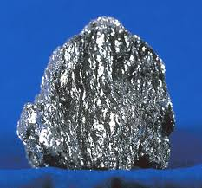
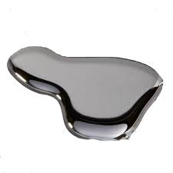
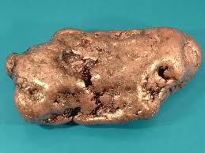
Classifying Elements
Metals
Shiny, conduct heat and electricity, malleable, ductile
All are solid except mercury
Examples: copper (Cu), tin (Sn), lead (Pb), iron (Fe), gold (Au), mercury (Hg)

Slide 7
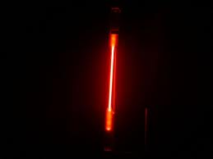
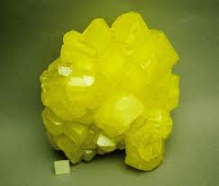
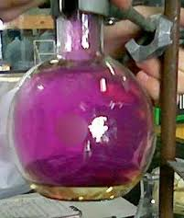
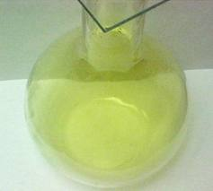
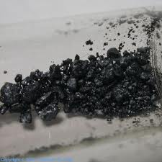
Classifying Elements
2. Nonmetals
Opposite of metals
dull, poor conductors heat and electricity, brittle, not malleable, not ductile
Can be solid, liquid, or gas
Examples: sulfur (S), iodine (I), neon (Ne), chlorine (Cl), oxygen (O), hydrogen (H)

Slide 8
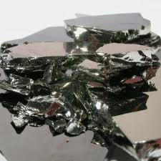
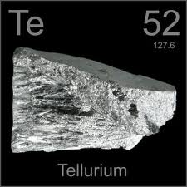
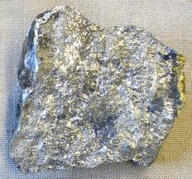
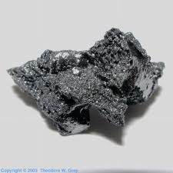
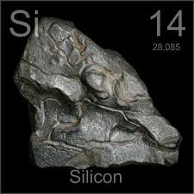
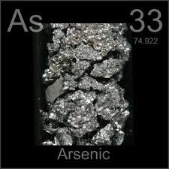
Classifying elements
3. Metalloids
Properties of both metals and nonmetals
Semi-conductors
Some shiny, some dull, somewhat malleable and ductile, some conduct heat and electricity
Solids
Examples: boron (B), silicon (Si), germanium (Ge), arsenic (As), antimony (Sb), tellurium (Te)

Slide 10
Compounds
Pure substance composed of two or more elements that are chemically combined.
Elements are rarely found alone in nature, so they combine with other elements.
Compounds form a particle called a molecule (two or more atoms joined together).
Found in a set ratio of elements
Examples of common compounds:
Table Salt
Sugar
Water
Hydrogen Peroxide
Vinegar
Carbon Dioxide
Baking Soda

Slide 11
Common Compounds
Compound | Elements Combined | Chemical Formula
Table salt | Sodium(Na) and chlorine(Cl) | NaCl
Water | Hydrogen(H) and oxygen(O) | H₂O
Hydrogen Peroxide | Hydrogen(H) and oxygen(O) | H₂O₂
Sugar | Hydrogen(H), carbon(C), oxygen(O) | C₁₂H₂₂O₁₁
Vinegar | Hydrogen(H), carbon(C), and oxygen(O) | C₂H₄O₂
Carbon dioxide | Carbon(C) and oxygen(O) | CO₂
Baking Soda | Sodium(Na), hydrogen(H), carbon(C), and oxygen(O) | NaHCO₃

Slide 12
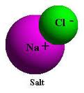
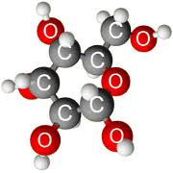
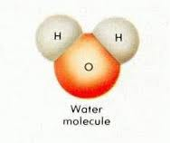
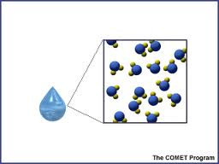
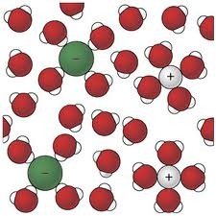
sugar

Slide 13
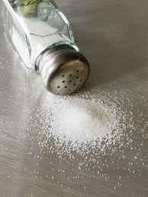
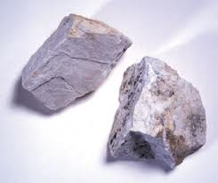
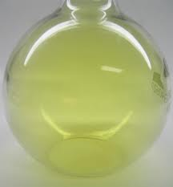
Properties of Compounds
Identified by physical and chemical properties
Compounds have different properties than the elements that form them.
Forming Sodium chloride (NaCl)
Sodium is a soft, silver white metal that reacts violently in water
Chlorine is a poisonous, greenish yellow gas
Sodium Chloride is a white solid. It dissolves easily in water and is safe to eat.

Slide 14
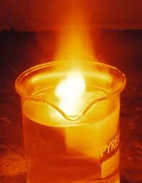
Sodium reacting with water

Slide 15
Mixtures
A combination of two or more substances that are not chemically combined
When mixed, the substances do not react
No chemical change happens
Each substance in the mixture keeps its identity
Do not have a set ratio of components
Separated through physical methods
Distillation – separates based on boiling points
Magnet - separates iron from other elements
Centrifuge – separates by densities
Filtration – separates by particle size

Slide 16
Mixtures vs. compounds
Mixtures | Compounds
Made of elements, compounds, or both | Made of elements
No change in original properties of components | Change in original properties of components
Separated by physical means | Separated by chemical means
Formed using any ratio of components | Formed using a set ratio of components

Slide 17
Solutions
A mixture that appears to be a single substance
One substance is dissolved in another substance
Solute – substance that is dissolved
Solvent – substance in which the solute is dissolved
Soluble – able to dissolve
Insoluble – unable to dissolve
Examples of solutions:
Salt water
Sugar water
Gasoline
Soft drinks
Air
Brass
steel

Slide 18
Solutions
States | Examples | Components
Gas in gas | Dry air | Oxygen in nitrogen
Gas in liquid | Soft drinks | Carbon dioxide in water
Liquid in liquid | Antifreeze | Alcohol in water
Solid in liquid | Salt water | NaCl in water
Solid in solid | Brass | Zinc in copper

Slide 19
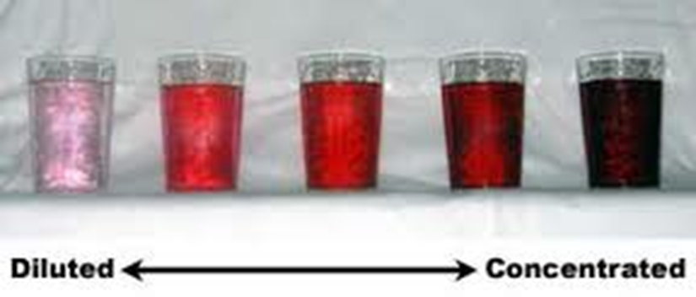
Concentration of solutions
Concentration – measure of the amount of solute dissolved in a solvent
Expressed in g/mL
Concentration = $\frac{grams of solute}{mL of solvent}$
Concentrated solutions contain more solute per solvent
Dissolving solids in liquids faster
Mixing or stirring
Heating
Crushing

Slide 20
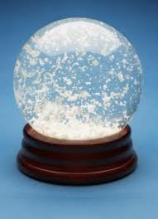
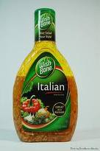
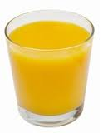
suspensions
Mixture in which particles of a material are dispersed throughout a liquid or gas but large enough to settle out
Can be separated by filtration
Examples:
Snow globe
Italian dressing
Paints
Medicines
Orange juice

Slide 21
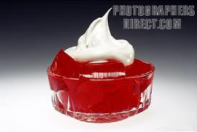
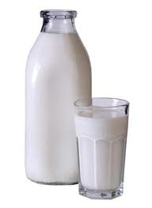
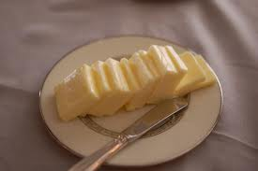
Colloids
Mixture in which the particles are dispersed throughout but are not heavy enough to settle out
Have properties of both solutions and suspensions
Cannot be separated by filtration
Examples:
Milk
Mayonnaise
Deodorant
Gelatin
Whipped cream
butter

