Slide 1
Estuaries: Aquatic vs. Terrestrial Organisms

Slide 3
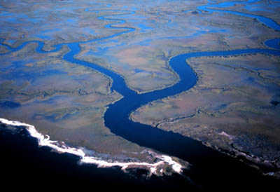
What happens when fresh & salt water meet?
Estuaries – When fresh water meets salt water…

Slide 4
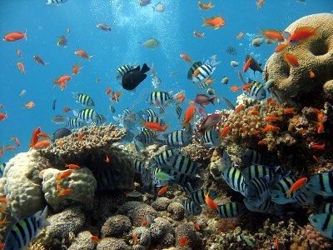
MAYBE A FRESH WATER CROCODILE WANTS A SALTY MEAL IN THE SEA!

Slide 5
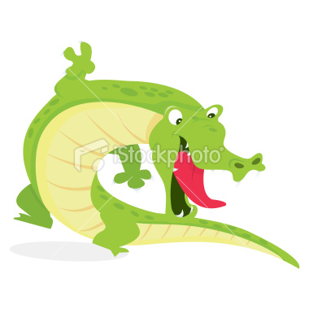
MAYBE A FRESH WATER CROCODILE WANTS A SALTY MEAL IN THE SEA!

Slide 6
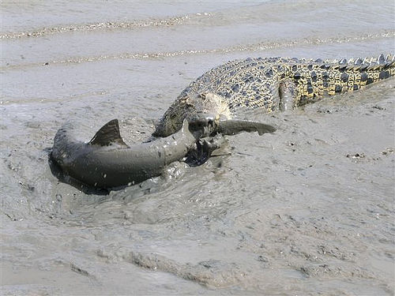
Maybe it wants a shark dinner!

Slide 7
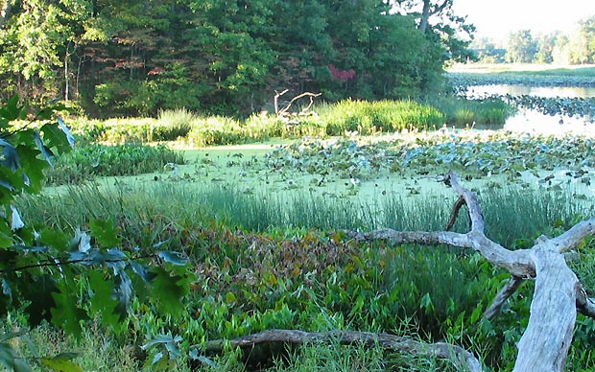
Double the plant life!!!!!

Slide 8
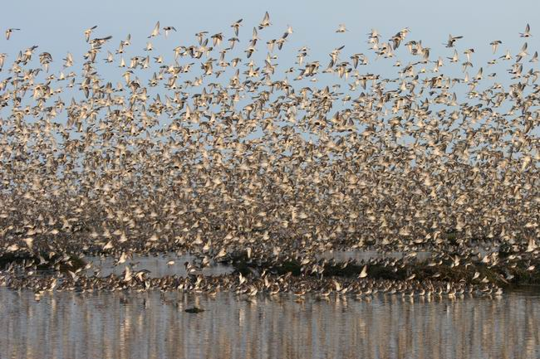
Birds always have something to eat.

Slide 9
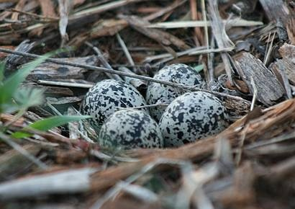
Birds have plenty of nesting sites too!

Slide 10
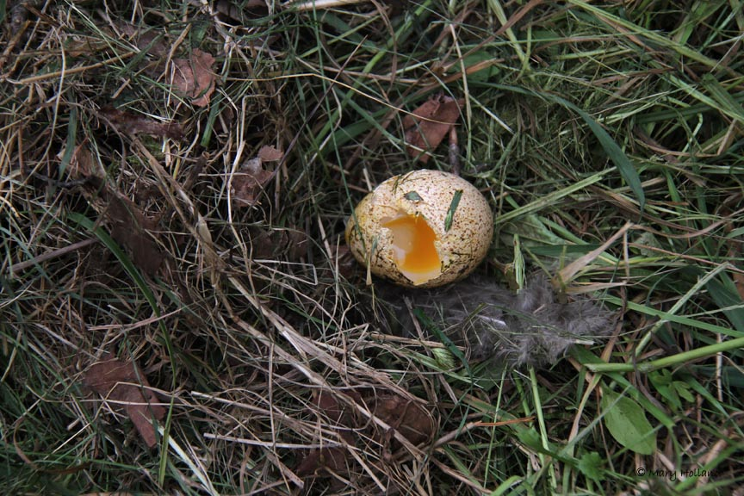
Birds have plenty of nesting sites too!

Slide 11
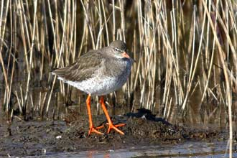
Birds have plenty of nesting sites too!

Slide 12
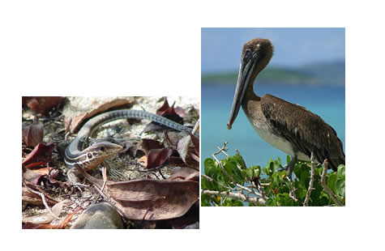
Estuaries have 2x life because 2 ecosystems are colliding!

Slide 13
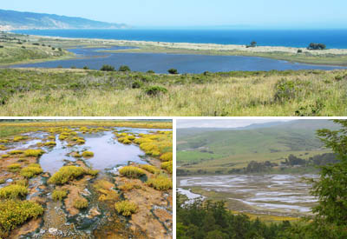
Estuaries have 2x life because 2 ecosystems are colliding!

Slide 14
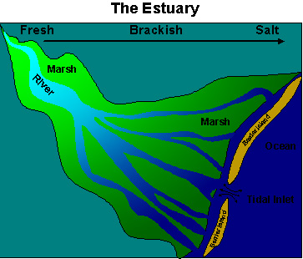
Fresh water rivers run into salty coastal waters. Two big groups of life breed & feed in the tall grasses of our estuaries.

Slide 15
When salt & fresh water mix, it is called brackish.

Slide 16
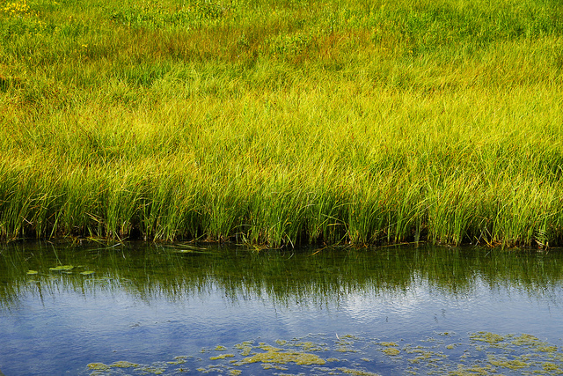
Estuaries: 2 X the breeding & feeding!

Slide 17
Estuaries: 2 X the breeding & feeding!
Fresh river & salt ocean water mix it up which causes
twice life & nutrients benefitting all.

Slide 18
2 types of estuaries:
Salt marsh
Mangrove forest

Slide 19
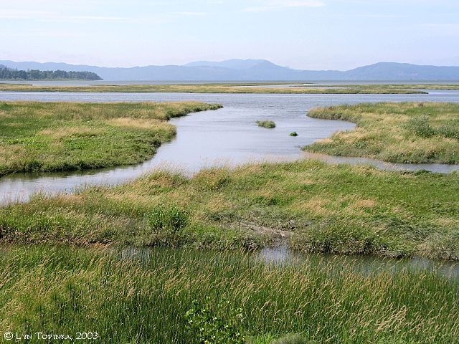
2 types of estuaries:
Salt marsh
Mangrove forest

Slide 20
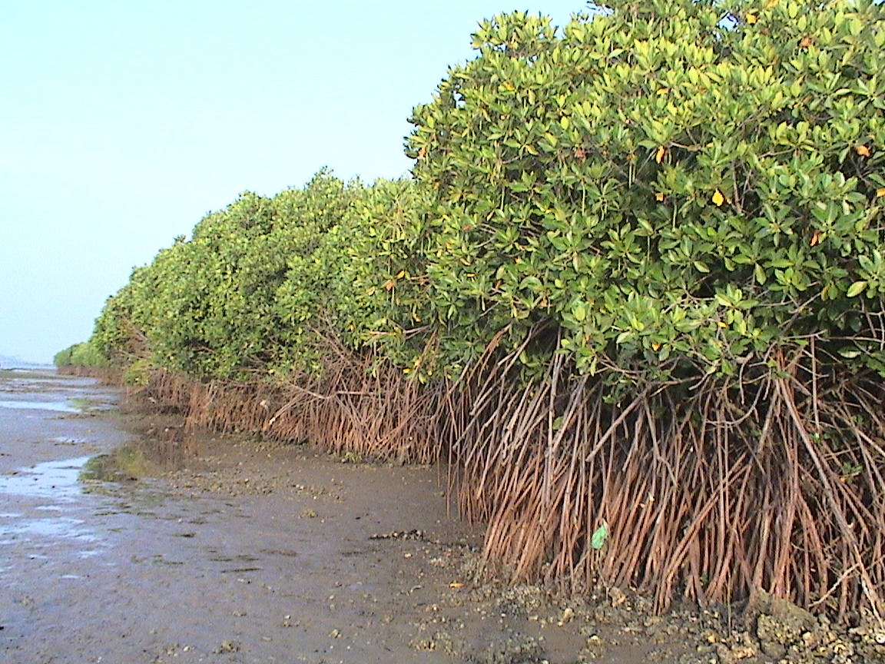
2 types of estuaries:
Salt marsh
Mangrove forest

Slide 21
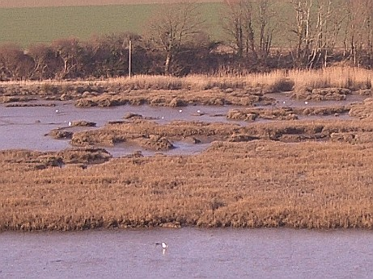
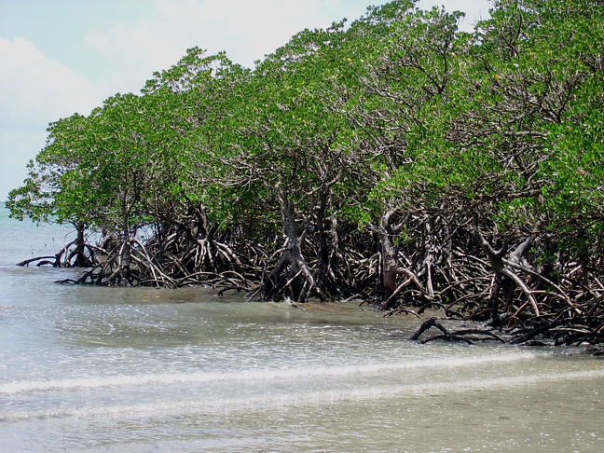
2 types of estuary:
SALT MARSH
Atlantic Carolina coasts
Stinky cord grass
Absorbs tons of moisture
MANGROVES
Louisiana & gulf
Hurricane proof trees
Absorbs tons of moisture
Great breeding grounds--nursery

Slide 22
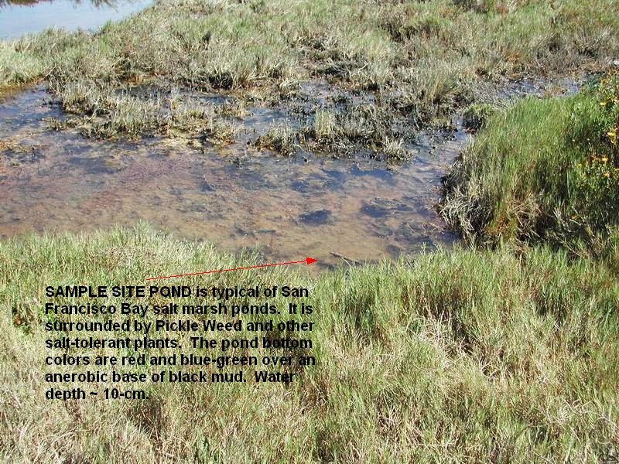
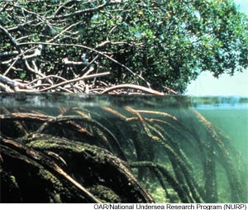
2 types of estuary:
SALT MARSH
Atlantic Carolina coasts
Stinky cord grass
Absorbs tons of moisture
MANGROVES
Louisiana & gulf
Hurricane proof trees
Absorbs tons of moisture
Great breeding grounds--nursery

Slide 23
2 types of estuary: 2X life & nutrients
SALT MARSH
Atlantic Carolina coasts
Stinky cord grass
Absorbs tons of moisture
MANGROVES
Louisiana & gulf
Hurricane proof trees
Absorbs tons of moisture

Slide 24
2 types of estuary: 2X life & nutrients
SALT MARSH
Atlantic Carolina coasts
Stinky cord grass
Absorbs tons of moisture
Great breeding grounds and nurseries for animals
MANGROVES Forests
Louisiana & gulf
Hurricane proof trees
Absorbs tons of moisture
Great nursery and breeding grounds for all kinds of animals

Slide 25
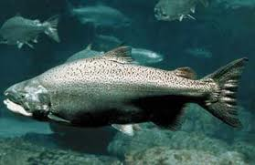
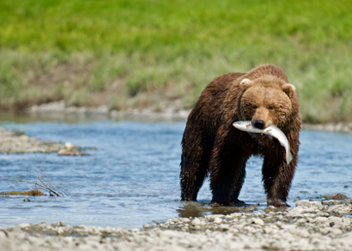
What types of organisms live in or around an estuary? .
FISH
SEAGULLS
CRABS
AND MUCH MORE…
Bears
Wolves
Birds
And much more…

Slide 26
Summary
Located along the shoreline where fresh water from a river meets salt water from the ocean.
Estuaries have twice the amount of life.
Estuaries are great places for organisms to lay eggs, have babies, and raise their young.
Estuaries absorb lots of water.
Estuaries absorb lots of pollution coming from a river.
There are two types of estuaries: salt marshes and mangrove forests.

