Slide 1
Label Paper like we do on every paper in class.
Visual Vocab. (Front Page)
(Definition and picture for EACH term)
All information is from Textbook Ch. 1 pgs B7-B34
Geological evolution | Biological evolution | Evolution | Mass extinction
Isolation (evolution) | Natural selection | Speciation | Variation
overproduction | Vestigial organs | Selection (competition) | ancestor
Captured thoughts (backside bottom half)
In a MINIMUM of 2 well developed sentences EACH, explain the following:
Explain the main idea
Explain how this connects to your life
Explain what you found interesting and why
Explain anything you wonder or want additional information on.
Darwin vs Lamarck (Backside top half)
Explain both theories
Give examples of each in way you can remember (besides the ones I gave)
Include pictures of both

Slide 2
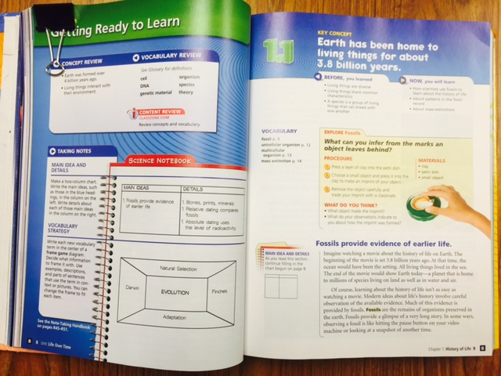

Slide 3
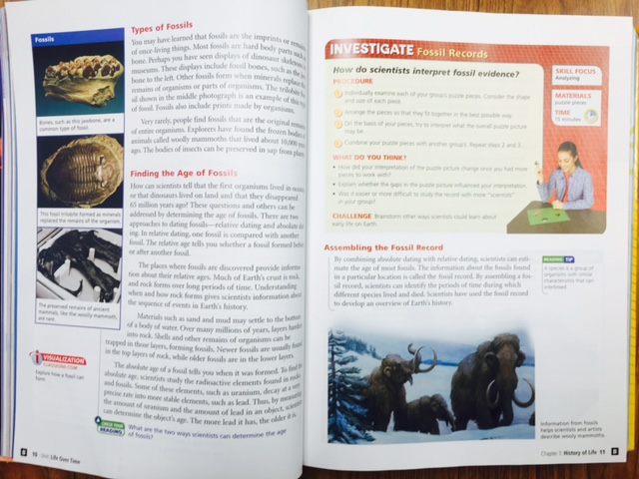

Slide 4
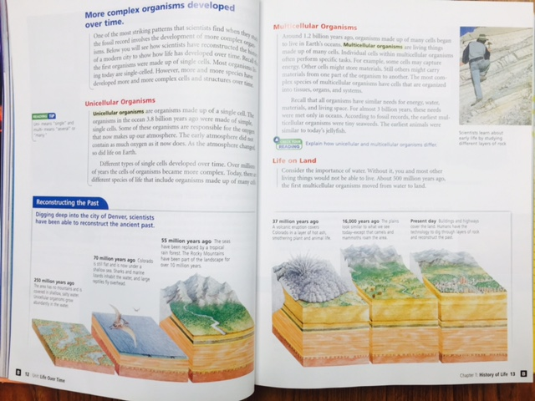

Slide 5
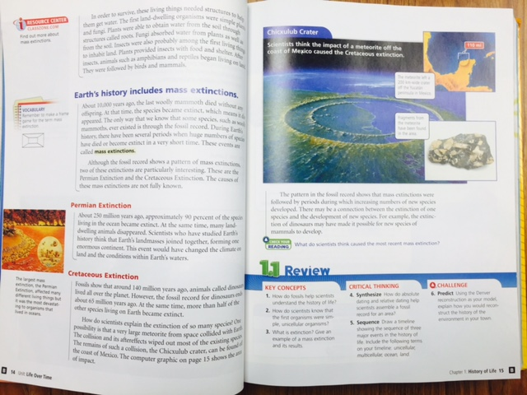

Slide 6
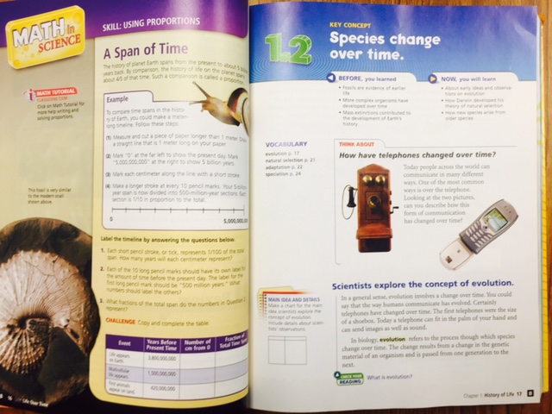

Slide 7
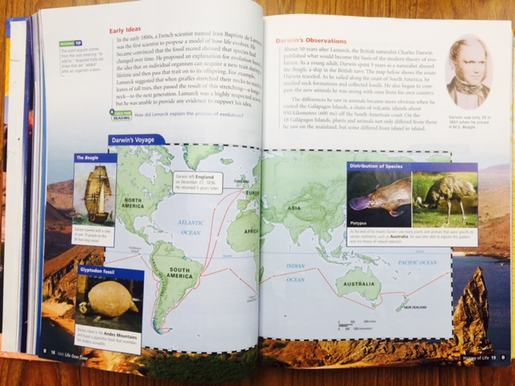

Slide 8
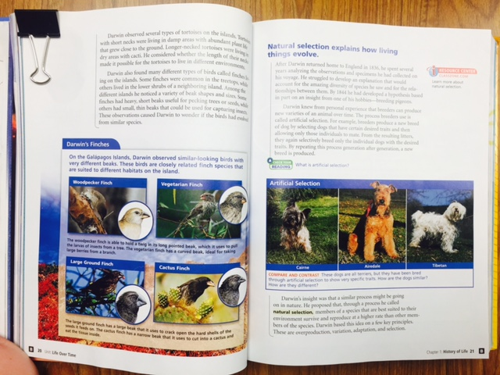

Slide 9
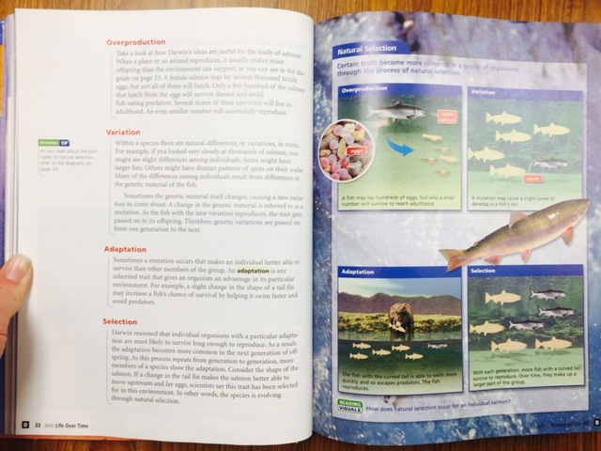

Slide 10
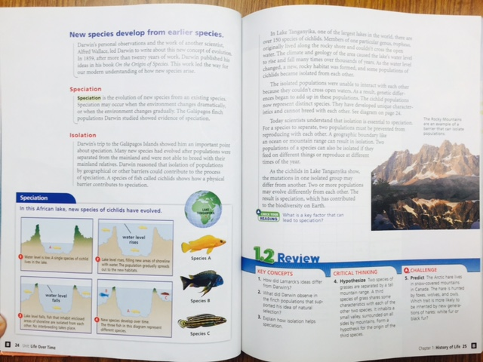

Slide 11
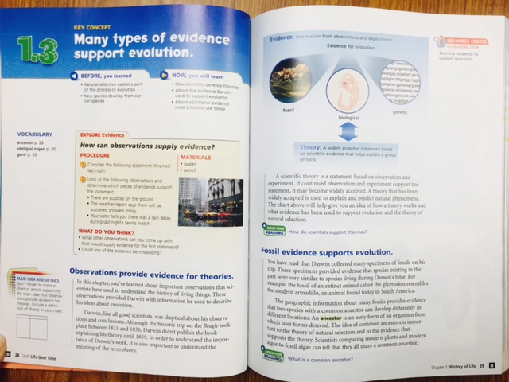

Slide 12
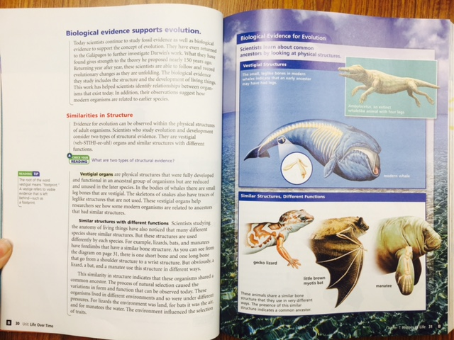

Slide 13
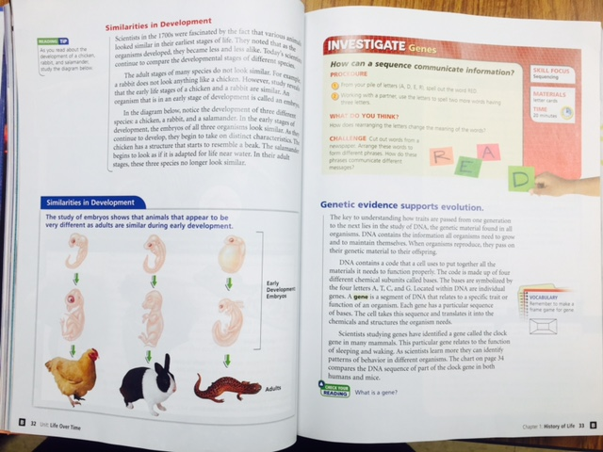

Slide 14
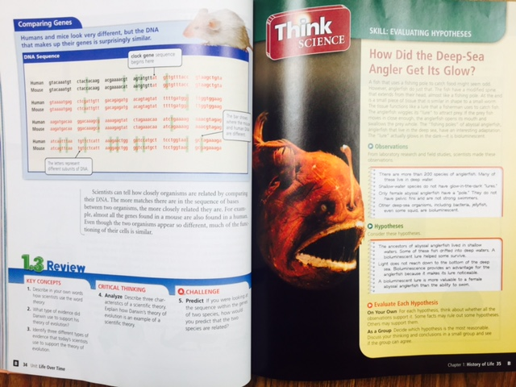

Slide 15
Works Cited
Littell, McDougal. "Chapter 1: The History of Life on Earth." McDougal Littell Science Grade-8. USA: McDougal Littell. B7-B35. Print.

