Slide 1
Evolution: Natural Selection

Slide 2
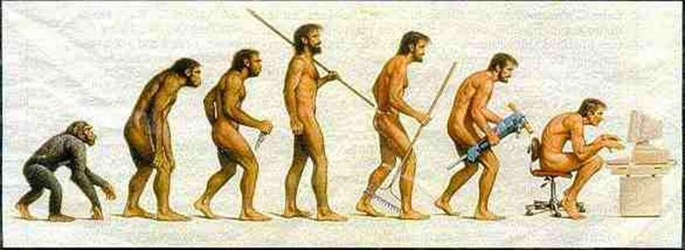
Warm-up
Explain what is going on in this picture in a short narrative format. Be creative with your story. Include why this species has to change and what you think their next change will be

Slide 3
It is how the EARTH changes over millions of years!!!
YOU KNOW WHAT GEOLOGICAL EVOLUTION IS , RIGHT???

Slide 4
What THEORY do we follow regarding GEOLOGICAL EVOLUTION?
The THEORY of PLATE TECTONICS!!!!!!
You know this! It is that the Earth is made up of pieces called PLATES.
Plates move around the Earth very slowly on magma, sometimes colliding (converging to form mountains & volcanoes) sometimes diverging (to form wider oceans and hydrothermal vents).

Slide 5
It is how life changes over many thousands of years!
What about BIOLOGICAL EVOLUTION?

Slide 6
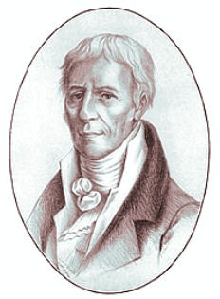
What THEORY do we follow regarding BIOLOGICAL EVOLUTION?
LAMARK had a good theory…
He proposed that living things can acquire (get) new traits throughout their lifetime …
& pass them onto their offspring.

Slide 7
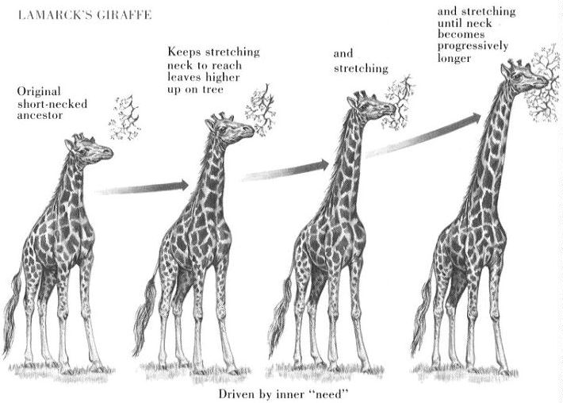
Like this giraffe…

Slide 8
While Lamark’s theory fell “short,” it still has some merit in the field of epigenetics.
Some of our genes (DNA instructions) can switch on or off during our lifetimes.
Making it possible for offspring to acquire new “improved” instructions on surviving.

Slide 9
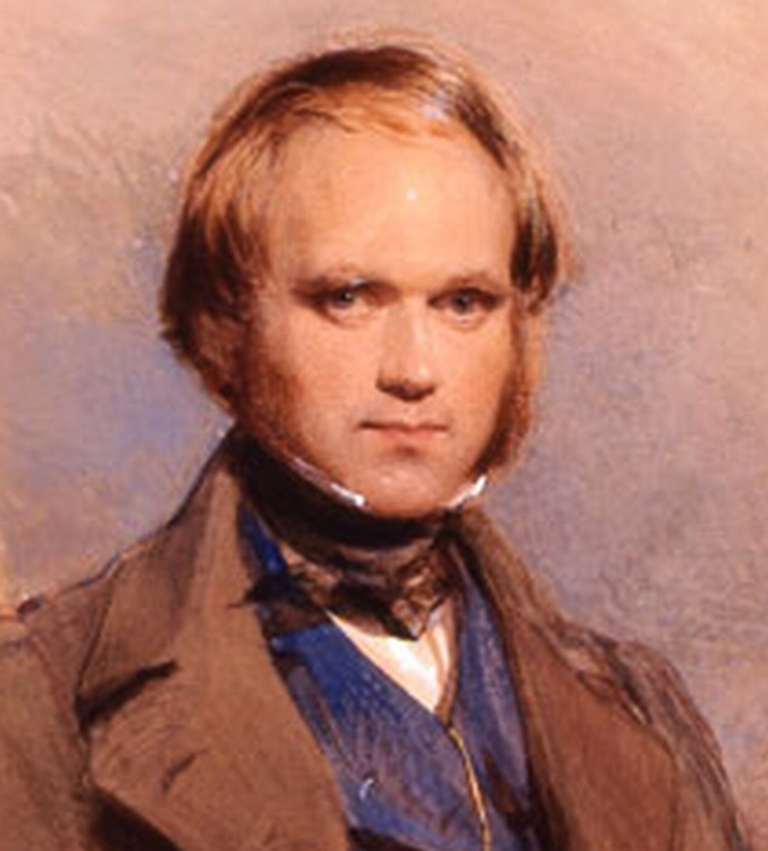
What THEORY do we follow regarding BIOLOGICAL EVOLUTION?
DARWIN’s
Theory of
NATURAL SELECTION!

Slide 10
HOW does his Theory of Natural Selection work?
IT HAS FOUR (4) PRINCIPLES:

Slide 11
HOW does the Theory of Natural Selection work????
Most living things have more babies than will normally survive.
This is called:
1. OVERPRODUCTION

Slide 12
Here’s some examples of OVERPRODUCTION:
Snapping turtles can lay 30 to 80 eggs at a time!

Slide 13
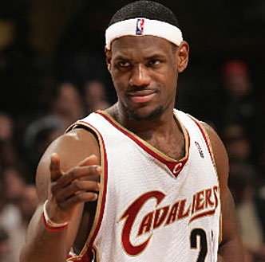
With all these babies, you are bound to have VARIATIONS (differences). [#2]
Some babies will be big,
some small….
Some babies will be smart,
Some babies will be athletic.

Slide 14
With too many living things around, things are going to get rough!
THERE’S LOTS OF
COMPETITION!!!

Slide 15
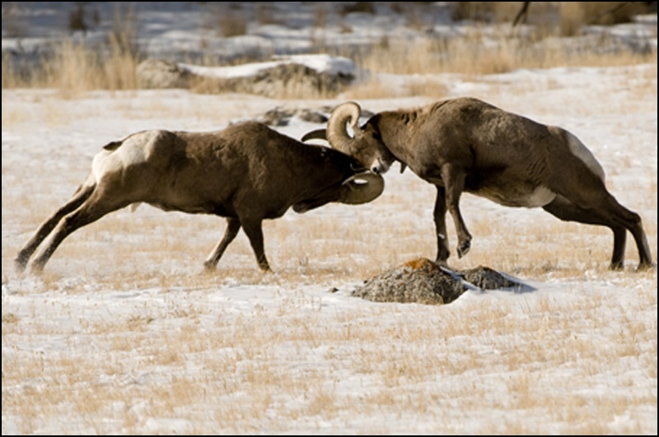
With too many living things around, things are going to get rough!
THERE’S LOTS OF
COMPETITION!!!
…for status,

Slide 16
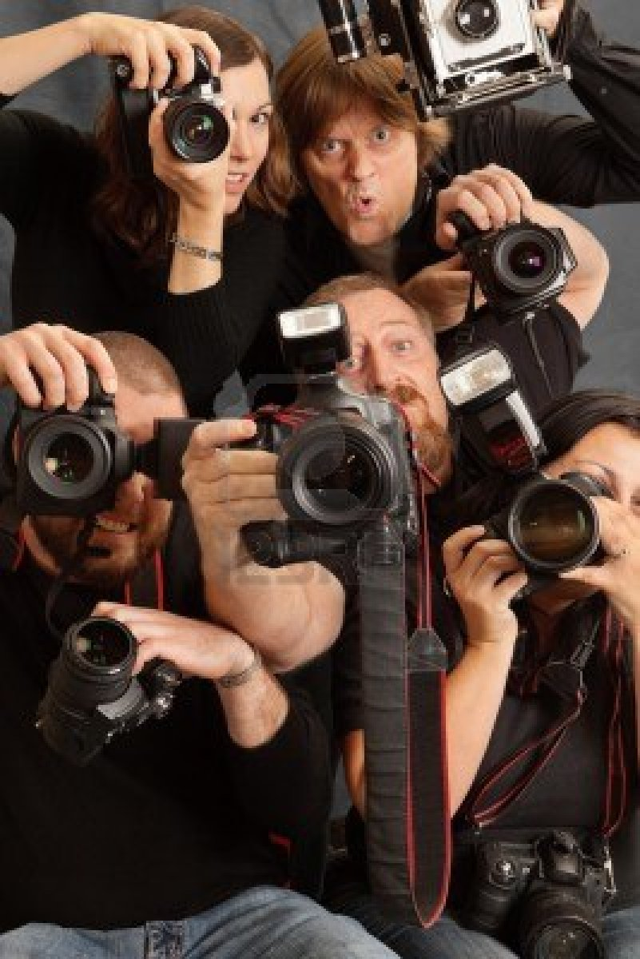
With too many living things around, things are going to get rough!
THERE’S LOTS OF
COMPETITION!!!
…for space …opportunities,

Slide 17
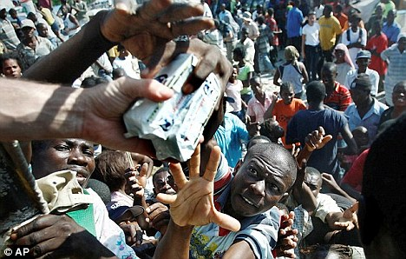
With too many living things around, things are going to get rough!
THERE’S LOTS OF
COMPETITION!!!
…for food!

Slide 18
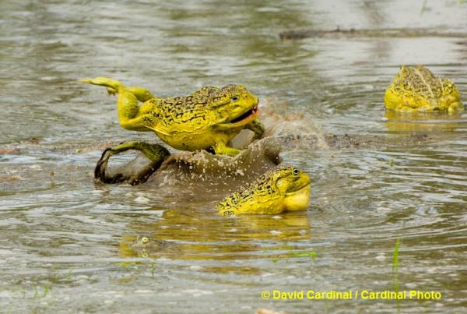
With too many living things around, things are going to get rough!
THERE’S LOTS OF
COMPETITION!!!
…for mates!

Slide 19
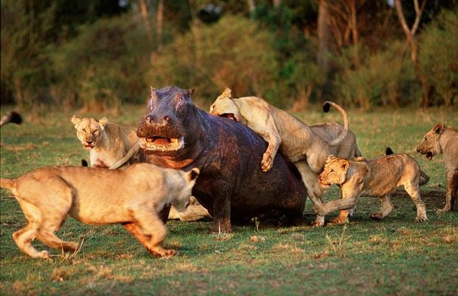
With too many living things around, things are going to get rough!
THERE’S LOTS OF
COMPETITION!!!
…for LIFE!

Slide 20
In nature, COMPETITION does NOT always favor the mighty.
Sometimes it is the LUCKY or MOST PREPARED who win!

Slide 21
THIS GOES ON FOR GENERATION AFTER GENERATION and so on…
AND SO IT GOES, THROUGH NATURAL SELECTION, A SINGLE SPECIES OVERPRODUCES has VARIATIONS OF OFFSPRING (some with mutations) WHO THEN MUST COMPETE TO survive and reproduce!

Slide 22
AFTER HUNDREDS OF THOUSANDS OF YEARS, SCIENTISTS BELIEVE A SPECIES CAN EVOLVE INTO ANOTHER NEW, MORE SUCCESSFUL SPECIEs!!!!!
After MANY THOUSANDS of YEARS, a single species undergoes ADAPTATION (#4) where its entire race takes on fresh characteristics of the most successful competitors selected of its kind!!!

Slide 23
Key words for the THEORY of NATURAL SELECTION:
OVERPRODUCTION (too many babies than will survive)
VARIATION (all with different traits plus occasional genetic mutations)
COMPETITION (selection of a winner)
ADAPTATION (over many, MANY generations these most beneficial traits endure (last)!)

Slide 24
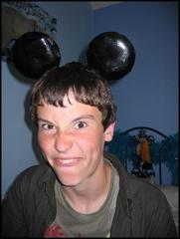
That’s why we call the Theory of Natural Selection…
SURVIVAL OF THE FITTEST!

