Slide 1
Fossils & Law of Superposition Notes

Slide 2
Explain the use of fossils, ice cores, sedimentary rocks, faults, and igneous rock formations found in rock layers as evidence of the history of the Earth and its changing life forms.
8.E.2.2

Slide 3
What are fossils?
Fossils are traces or remains of living things from long ago.

Slide 4
Looking at Fossils
The remains or traces of physical evidence of an organisms preserved by key geologic processes is called a fossil.
Fossils are important because they give us clues about the past
Most fossils are hardened animal remains such as shells, bones, teeth, and skeletal body parts
Other fossils are impressions or preserved organisms found in rock

Slide 5
So How are Fossils Made?
Conditions have to be just right for fossils to from in rock
Organisms must be preserved before it decomposes or disappears
Usually soft parts decays too fast, which is why fossils only really show hard parts of plants and animals
Fossils form in the layers of sedimentary rock

Slide 6
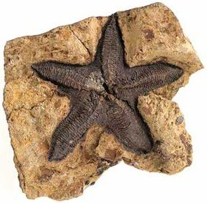
Original Remains
Fossils that are the actual bodies or body parts of organisms are called original remains
Original remains are found in places where conditions prevent the decomposition or breakdown to occur

Slide 7
Traces of Remains
Ice – best preserver of prehistoric life. Ice has preserved original remains of things such as a 10,000 year old mammoth which have been found with bones, muscles, skin, and hair still in place
Amber – formed from the sticky substance inside trees that flows like syrup. If an insect is caught in the sap, the sap will cover the insects entire body and harden.
Tar – thick, oily pool of liquid. Things such as saber toothed cats and other animals were trapped and preserved

Slide 8
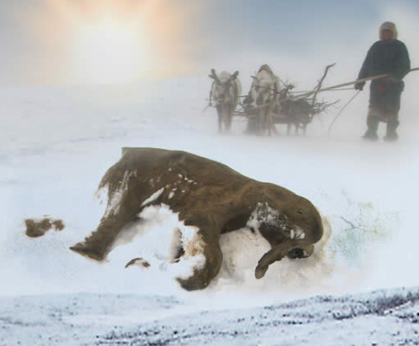
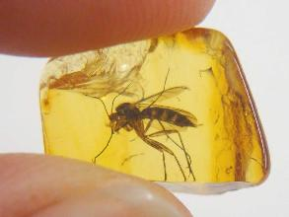
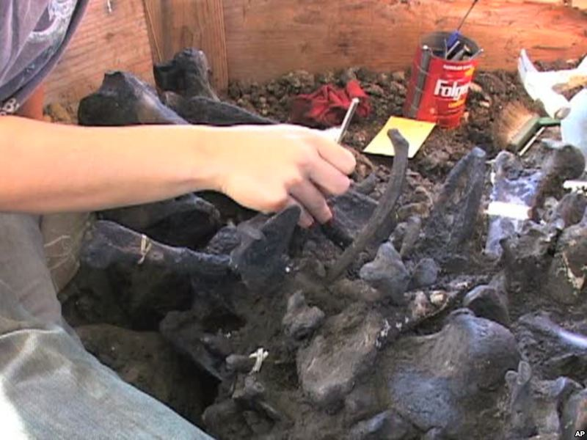
Traces of Remains

Slide 9
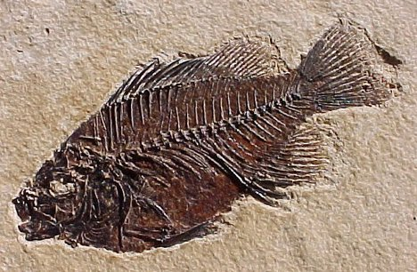
Fossils in Rocks
If an organism is caused by or buried in sediment it may become a rock
Some fossils are not original remains or actual body parts, instead they are impressions or traces made in rock.

Slide 10
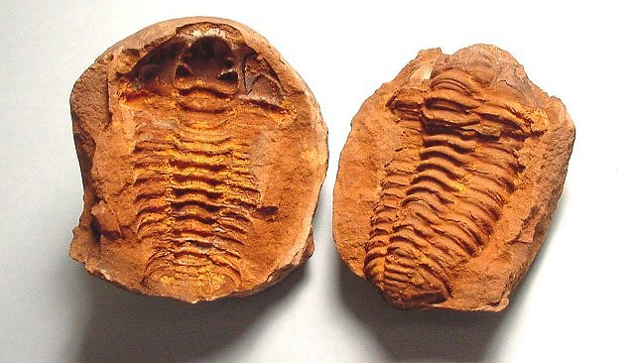
Types of Rocks
Molds and Casts:
A mold is a visible shape that was left after an animal or plant was buried in sediment and then decayed away.
A cast is an object that is created when sediment fills a mold and becomes rock.

Slide 11
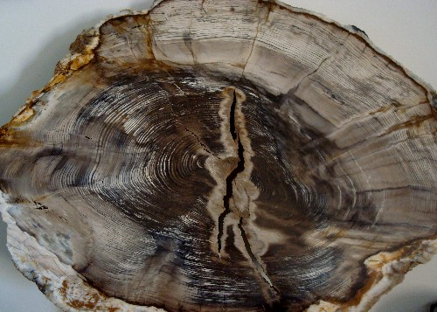
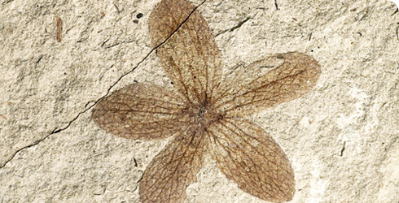
Types of Rocks Con’t
Petrification
The process in which minerals pass through and replace the organisms cells with minerals which produces a stone-likeness to the object. Commonly happens with trees that die and are covered in sediment
Carbon Films
Carbon is found in every living thing. Sometimes when a dead plant or animal decays, a visible carbon layer is left behind. These show the soft parts of these organisms that are rarely seen in other fossils

Slide 12
Trace Fossils
Preserved evidence of animal activity or movement
Examples:
Tracks – which tells us the size of animal and speed
Burrows – shelters made by animals buried in sediment
Feces – preserved animal poop

Slide 13
What is a fault?
a fault is a break in the rocks that make up the Earth’s crust together with movement of the rock on either side

Slide 14
What is an Ice Core?
cylindrical samples of ice removed from ice sheets and glaciers that contain detailed information about the history of the Earth

Slide 15
What are Sedimentary Rocks?
rock that is formed when sediment is deposited (by water or wind) and becomes solid – it often is deposited in layers and frequently contains fossils

Slide 16
What are Igneous rocks?
rocks formed by the cooling and solidifying of molten materials

Slide 17
What do rocks tell us?
Rocks bear evidence of the minerals, temperatures, and forces that created it.

Slide 18
What do rocks, fossils, and ice cores show us?
Life forms have changed over time
Earth’s climate and surface have changed over time

Slide 19
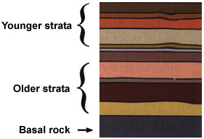
What is the Law of Superposition?
The Law of Superposition states that each undisturbed rock layer is older than the layer above it.
This law is used to read rock layers.
Strata = LAYER

Slide 20
How does the Law of Superposition relate to sedimentary rocks?
Thousands of layers of sedimentary rocks confirm the long history of the changing surface of the earth and the changing of life forms whose remains are found in successive layers.
Successive = following in uninterrupted order; consecutive

Slide 21
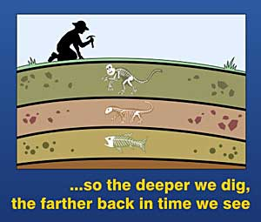

Slide 22
Who studies rocks and fossils?
Geologist = a scientist that studies Earth’s processes

Slide 23
Why do Geologist study rocks and fossils?
By studying rocks and fossils, geologist have developed a geologic time scale which outlines the major divisions of Earth’s history.
Geologic time scale – the standard method used to divide the Earth’s long natural history into manageable parts

