Slide 1
Precambrian | Paleozoic | Mesozoic | Cenozoic
GEOLOGICAL | GEOLOGICAL | GEOLOGICAL | GEOLOGICAL
Biological | Biological | Biological | Biological

Slide 2
Precambrian Era
The Precambrian Era is Earth's first era of time. It began with the creation of the Earth around 4.6 billion years ago.
5 major events occurred during this era:
the formation of the Sun and light
the creation of the Earth
the creation of the atmosphere through volcanic out-gassing
the creation of the oceans
the creation of life.

Slide 3
Precambrian Era
Began with simple life forms such as bacteria and simple algae.
There was a rise of simple organisms such as jellyfish and sea worms by the end of the era.
Few fossils because the life forms were soft-bodied and had no hard skeleton.

Slide 4
Paleozoic Era
Began with the early invertebrates, such as trilobites and brachiopods; continued to develop early vertebrate fish, then
arachnids and insects; later came the first amphibians, and near the era’s end the reptiles became dominant.
Early land plants included simple mosses, ferns, and then cone-bearing plants.
By the end of the era, seed plants were common.
The mass extinction that ended the era caused most marine invertebrates as well as amphibians to disappear.

Slide 5
Mesozoic Era
Reptiles were the dominant animals of this era, including the various dinosaurs.
Small mammals and birds also appeared.
Toward the end of the era, flowering plants appeared and the kinds of mammals increased.
The mass extinction that ended the era caused the dinosaurs to become extinct.

Slide 6
Cenozoic Era
New mammals appeared while others became extinct.
The diversity of life forms increased.
Flowering plants became most common.
Humans are also part of the most recent period of this era.

Slide 7
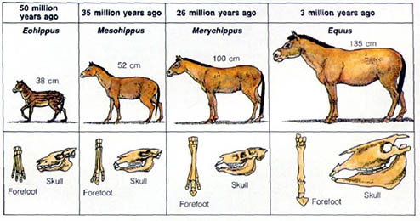
Evolution*
The process by which different kinds of living organisms are theorized to have developed and diversified from earlier forms throughout the history of the earth.

