Slide 1
Infectious Diseases NOTES
8.l.1.1 Summarize the basic characteristics of viruses, bacteria, fungi, and parasites relating to the spread, treatment, and prevention of disease.
8.L.1.2. Explain the difference between epidemic and pandemic as it relates to the spread, treatment, and prevention of disease.

Slide 2
The study of….
PATHOLOGY
the science of the causes and effects of diseases
MICROBIOLOGY
study of microorganisms and their effect on living things
EPIDEMIOLOGY
deals with the incidence, spread, and control of diseases
BIOTECHNOLOGY
use of microorganisms to perform specific industrial functions

Slide 3
Types
Viruses
Bacteria
Fungi
Parasites
Affect: Humans, Plants, and Animals.

Slide 4
Characteristics of living organisms
Made of Cells
Have levels of organization
Reproduce
Use energy
Grow
Respond to the environment
Adapt to the environment

Slide 5
Are Viruses Alive ?
Viruses are not alive.
do not meet all the characteristics of a living organism
WHY NOT?
Can reproduce only inside a live cell of the host
Not made of cells
They do not have metabolism because they are particles and not cells

Slide 6
Virus
non-living
DNA or RNA
need a host cell to replicate.
invade healthy cells to make more viruses, usually kill the cell
the most widespread illnesses in humans
Examples: AIDs, Chicken Pox, Flu (Influenza, H1N1), common cold.
http://youtu.be/7D0eIsuZC3w

Slide 7
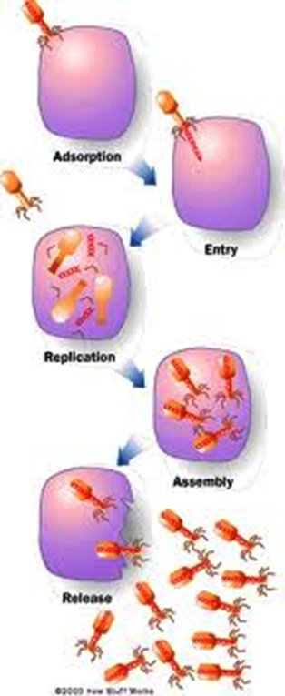
Lytic Cycle
1.Absorption
2. Entry
3. Replication
4. Assembly
5. Release

Slide 8
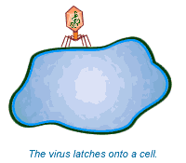
ABSORPTION

Slide 9
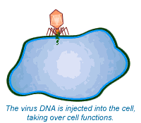
ENTRY

Slide 10
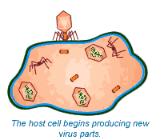
REPLICATION

Slide 11
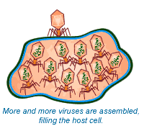
ASSEMBLY

Slide 12
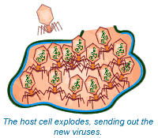
RELEASE

Slide 13
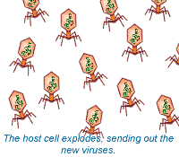

Slide 14
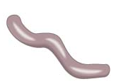
Bacteria
Cocci
Spirilla
single-celled organism
live in a variety of places (with oxygen, without oxygen, extreme hot, extreme cold).
grow and reproduce rapidly
Examples: Cholera, Salmonella (food poisoning), pneumonia, Lyme disease, tetanus, tuberculosis, strep throat, meningitis.
Bacteria VS Virus
http://youtu.be/ZzdRj60S4NQ
Baccili

Slide 15
Fungi
Fungi are heterotrophs.
Can reproduce in multiple ways
Fungi can sometimes attack the tissues of living plants and animals and cause disease.
Examples: Yeast, mold, mildew, ringworm
Symptoms: skin infections, yeast infection, athelete’s foot, thrush

Slide 16
Parasite
organism that feed on another organism, the host.
They live on or in their host’s body.
Infectious disease may also be caused by animal parasites, which may take up residence in the intestines, bloodstream, or tissues.
Some are vectors – an organism that spreads disease
Back by popular demand: The caterpillar and the wasps
http://youtu.be/vMG-LWyNcAs

Slide 17
Vaccine/Antibiotic
Vaccines are used to prevent the spread of viral diseases. Must be taken before your infected.
Antibiotics are used to stop the growth of bacteria.
Bacteria become resistant (antibiotic won’t kill them) causing it to be difficult to treat diseases.
ANTIBIOTICS will NOT KILL VIRUSES!!

Slide 18
Epidemic vs. Pandemic
epidemic and pandemic are similar terms that refer to the spread of infectious diseases among a population.
pandemic = more people infected, and a larger region being affected. World-wide outbreak.
Epidemic= local or smaller area not world-wide.

