Slide 1
Oceans
Characteristics
Features
Life Forms

Slide 2
The World’s Oceans
71% of the Earth’s surface is covered by water.
The oceans contain 97% of the earth’s water.
All the oceans and seas are actually one continuous body of water.
Oceanographers are scientists who study the ocean and its processes.

Slide 3
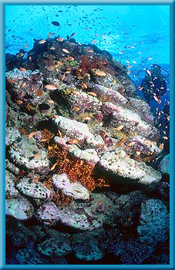
Importance of Oceans
Oceans affect all living things—even those far from the shore.
Oceans provide a place for many organisms to live.

Slide 4
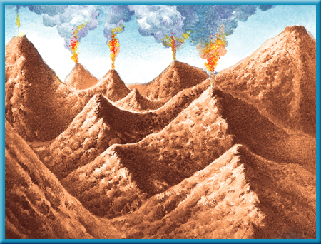
How were the oceans formed?
When Earth was still a young planet, many active volcanoes existed. As they erupted, lava, ash, and gases were released from deep within the Earth.
One of these
gases was
water vapor.

Slide 5
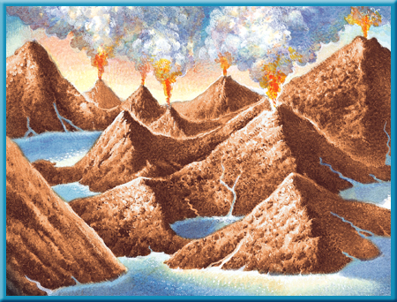
Formation of Oceans
Over millions of years, the water vapor cooled enough to condense and form clouds. Then torrential rains began to fall from the clouds.
Eventually, much
of the land was
covered by
water that formed

Slide 6
Oceans
Historically, the 4 oceans are the Atlantic, Pacific, Indian, and Arctic; However, many countries now recognize a 5th: Southern (Antarctic)
The Pacific Ocean is the largest ocean.
The area and volume of the Pacific Ocean are greater than the Atlantic and Indian combined.

Slide 7
Properties of Ocean Water
Ocean water is a mixture of gases and solids dissolved in pure water.
Oceanographers believe oceans contain all the natural elements on Earth.
85 of 90 have been found in the ocean.

Slide 8
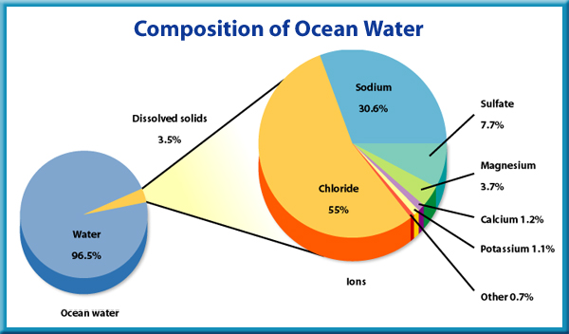

Salinity
Salinity describes the amount of dissolved salt in the ocean.
Salinity is expressed in parts per thousand.

Slide 9
Gases in Ocean Water
The most abundant gases in ocean water are nitrogen, carbon dioxide and oxygen.
The amounts of these elements vary with depth. They are more abundant at the ocean’s surface where sunlight causes more plant life.

Slide 10
Temperature of Ocean Water
Warm water holds less dissolved gas than cold water.
When ocean water is cold, like in polar regions, it sinks and carries oxygen rich water to the ocean depths.
As a result, fish and other animals can live in deep parts of the ocean.

Slide 11
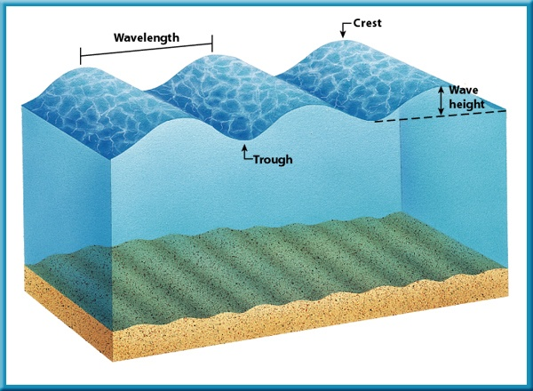
Waves
A wave in water is a rhythmic movement that carries energy through the water.
Waves are caused by high winds blowing on top of the water.

Slide 12
Tides
Throughout a day, the water level at the ocean’s edge changes. This rise and fall in sea level is called a tide.
A tide is a giant wave that can be thousands of kilometers long but only 1 m to 2 m high in the open ocean.
Tides are created by the gravitational attraction of Earth and the Moon and of Earth and the Sun.

Slide 13
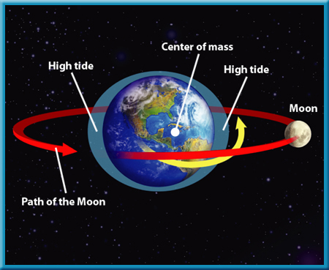
Tides

Slide 14
Ocean Currents

Slide 15
Vocabulary
Ocean Current
Coriolis Effect
Rip Current
Upwelling

Slide 16
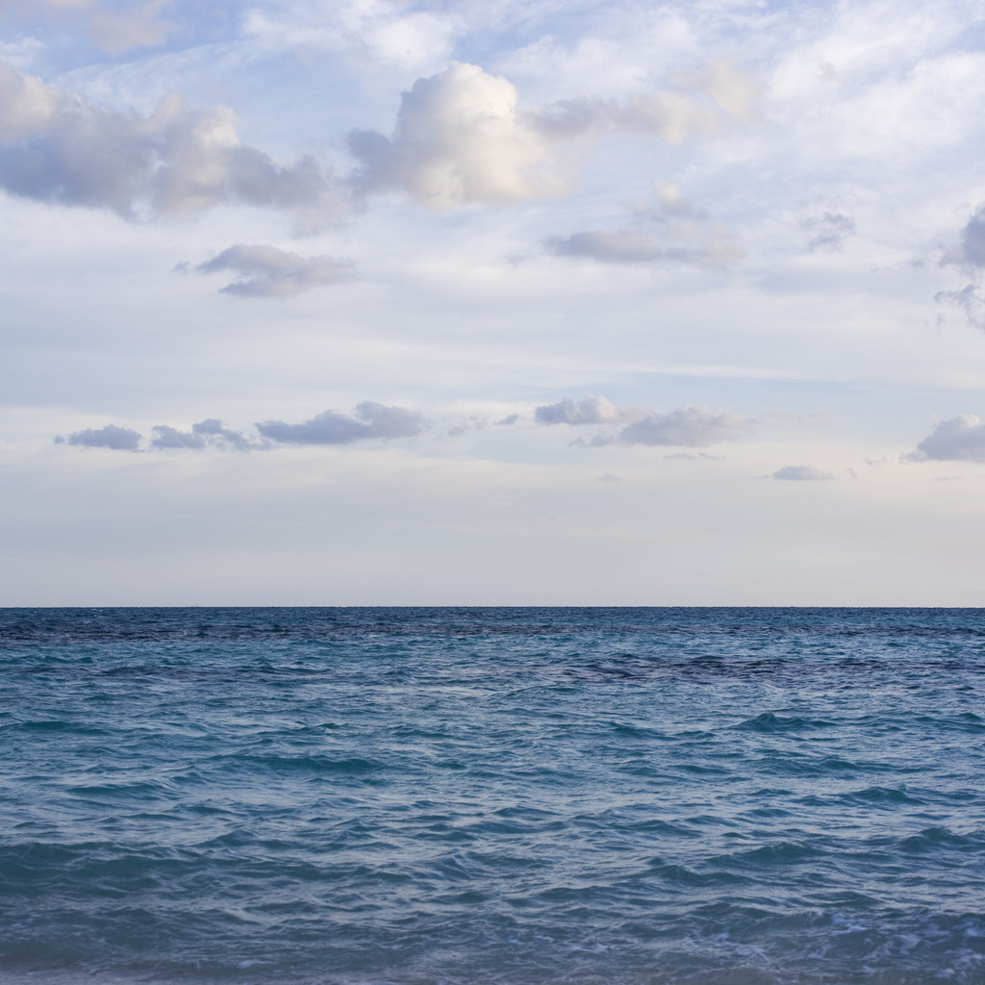
Major Ocean Currents
An Ocean Current is a large volume of water flowing in a certain direction.
Wind-driven currents are called surface currents.
Surface currents carry warm or cold water horizontally across the ocean’s surface

Slide 17
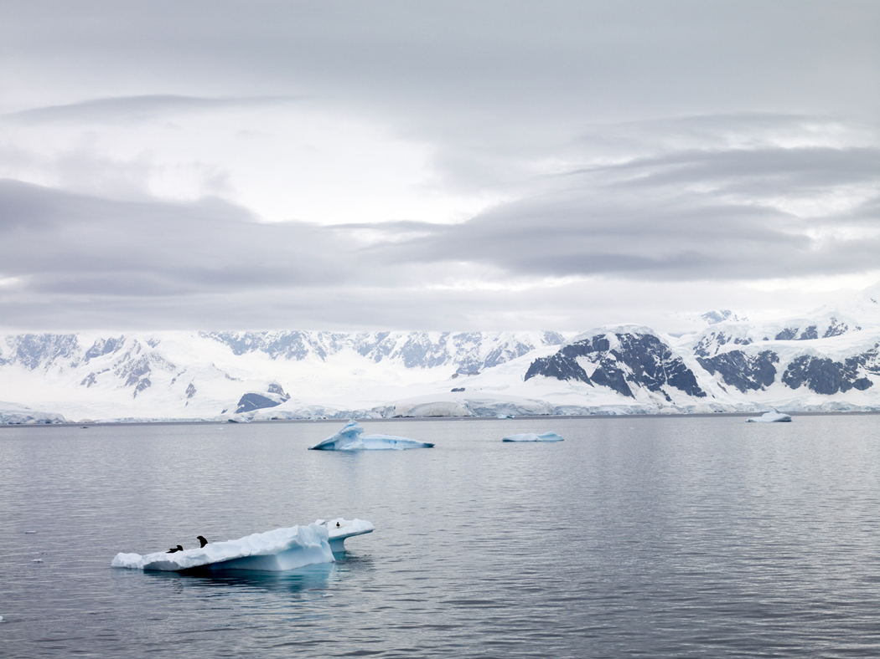
Major Ocean Currents
Surface currents extend to about 400 m below the surface, and they move as fast as 100 km/day.
Earth’s major wind belts, called prevailing winds, influence the formation of ocean currents and the direction they move.

Slide 18
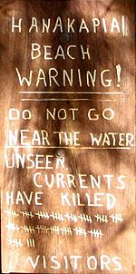
Rip Currents
A rip current is a narrow, powerful surface current which flows away from the shore.
It is caused by pressure building up from uneven buildup of water from waves.
They can flow very quickly and can be difficult to detect until you are in one.

Slide 19
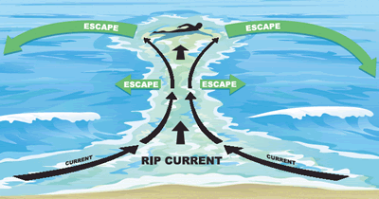
Rip Currents are Dangerous!
Rip currents are responsible for about 150 deaths every year in the United States.
About 80 percent of all beach rescues are related to rip currents.
Rip currents don’t pull swimmers under, they flow out for several miles.
If you get caught in a rip current, swim parallel to the shore until you are out of the current.

Slide 20
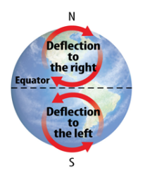
Coriolis Effect
The Coriolis Effect is the movement of wind and water to the right or left that is caused by Earth’s rotation.
It causes fluids such as air and water to curve to the right in the Northern hemisphere, in a clockwise direction.
The Coriolis effect also cases fluids to curve to the left in the southern hemisphere, in a counterclockwise direction.

Slide 21
Coriolis Effect
The shapes of continents and other land masses affect the flow and speed of currents.
Currents form small or large loops and move at different speeds, depending on the land masses they contact.

Slide 22
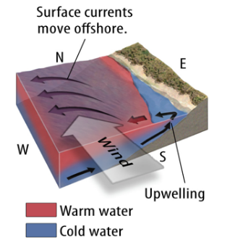
Upwelling
Upwelling is the vertical movement of water toward the ocean’s surface.
Upwelling occurs when wind blows across the ocean’s surface and pushes water away from an area. Deeper colder water then rises to replace it.
Upwelling often occurs along coastlines.
Upwelling brings cold, nutrient-rich water from deep in the ocean to the ocean’s surface.

Slide 23
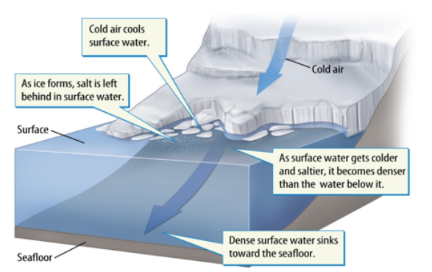
Density Currents
Density Currents are a type of vertical current that carries water from the surface to deeper parts of the ocean.
Density Currents are caused by changes in density rather than wind.
Density currents circulate thermal energy, nutrients and gases.

Slide 24
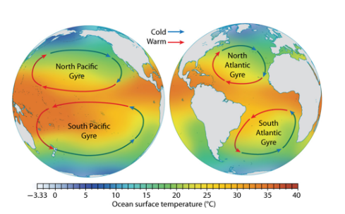
Impacts of Weather and Climate
Warm-water currents and cold-water currents affect weather and climate in different ways
Regions near warm-water currents are often warmer and wetter than regions near cold-water currents

Slide 25
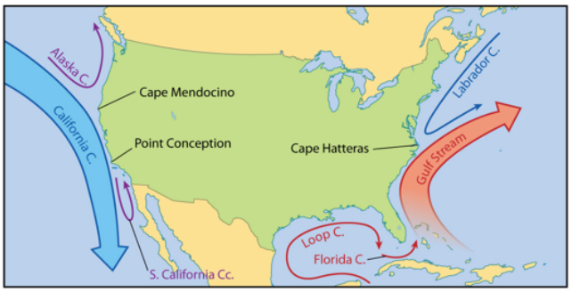
Impacts on Weather and Climate
The Gulf Stream is a warm-water current that affects coastal areas of the southeastern United States by transferring lots of thermal energy and moisture to the surrounding air.
The cold California Current affects coastal areas of the southwestern United States.

Slide 26
Great Ocean Conveyor Belt
The Great Ocean conveyor Belt is the name for a model of the large system of ocean currents that affects weather and climate by circulating thermal energy around Earth.
In this model, high salinity water cools and sinks in the North Atlantic, and deep water returns to the surface in the Indian and Pacific Oceans through upwelling

Slide 27
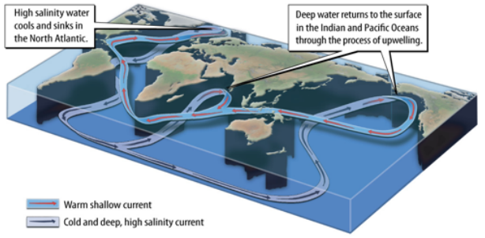
Great Ocean Conveyor Belt
Scientists estimate that the Great Ocean Conveyor Belt model takes about 1,000 years to complete a cycle.

