Slide 1
Ocean Exploration & Technologies NOTES

Slide 2
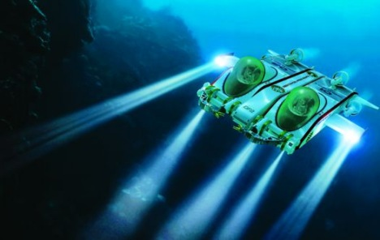
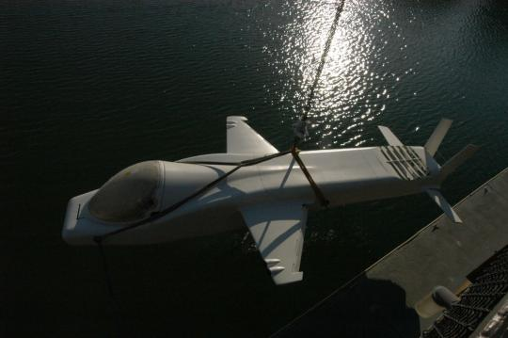
Deep ocean exploration
submersibles.

Slide 3
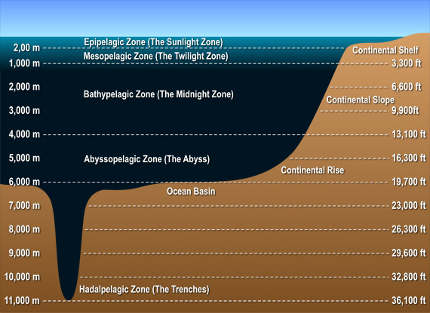
How deep can man travel?

Slide 4
submersibles can only go THIs deep. (HALF WAY DOWN)

Slide 5
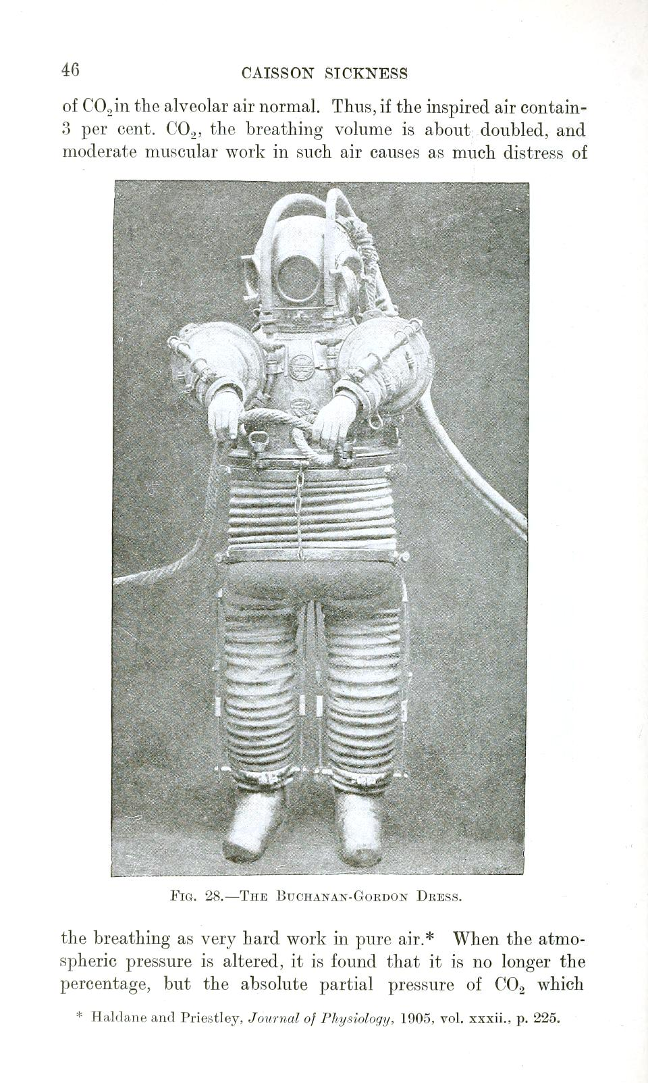
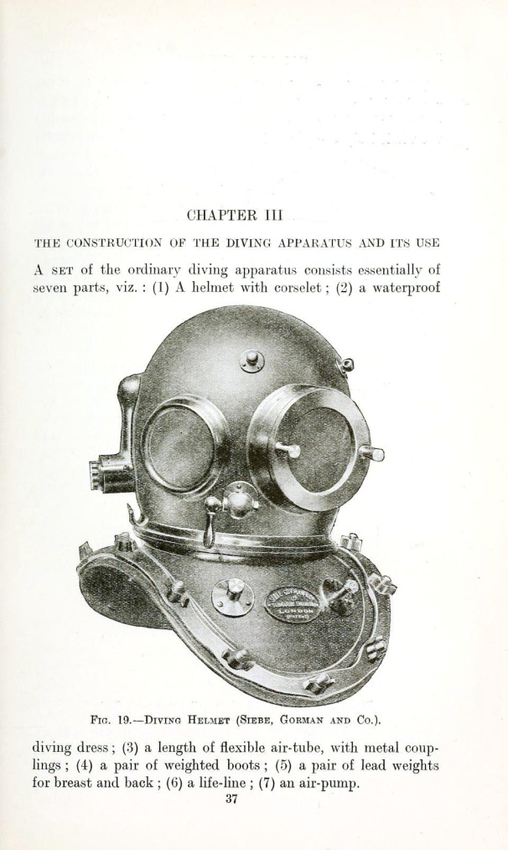
Why can’t we go deeper?
PRESSURE!!!!

Slide 6
So how do Marine biologists get this deep?

Slide 7
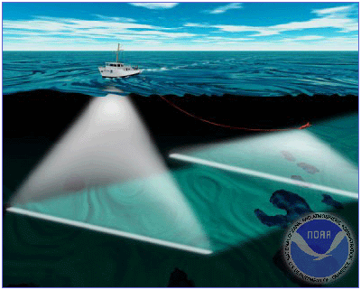
Deep ocean exploration & technology tells us!
submersibles.
SONAR (sound waves) MAP OCEAN FLOORS!

Slide 8
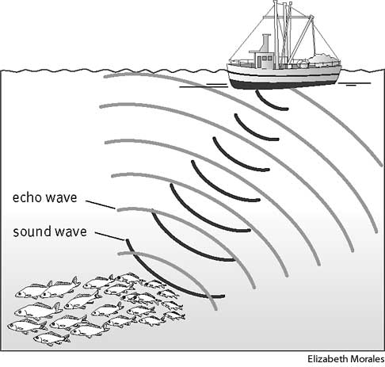
Deep ocean exploration & technology tells us!
sonar (sound waves) map sea floor.

Slide 9
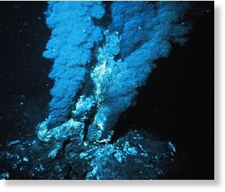
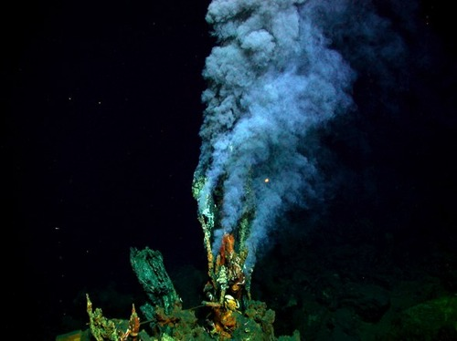
How does life exist in the ABYSS?
CHEMICAL ENERGY ! (not solar energy)
HYDROTHERMAL VENTS spew all sorts of gases for things to live on!
chemosynthetic (NOT photosynthetic) organisms

Slide 10
So how do scientists get videos & photos of things this deep?

Slide 11
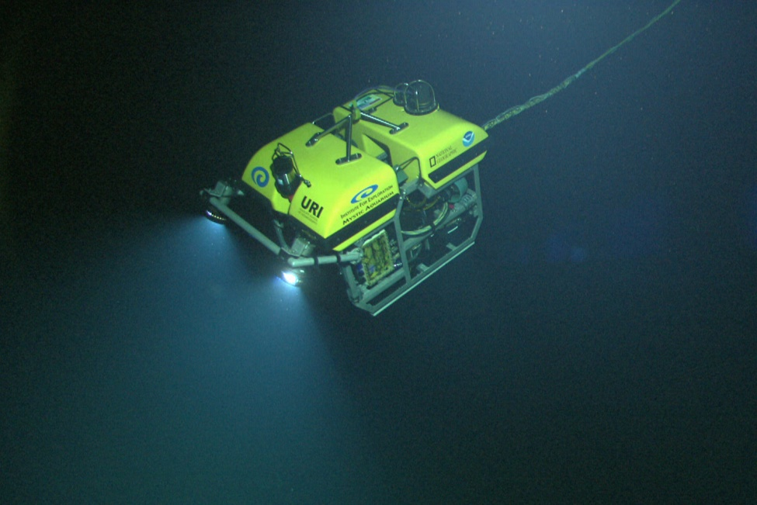
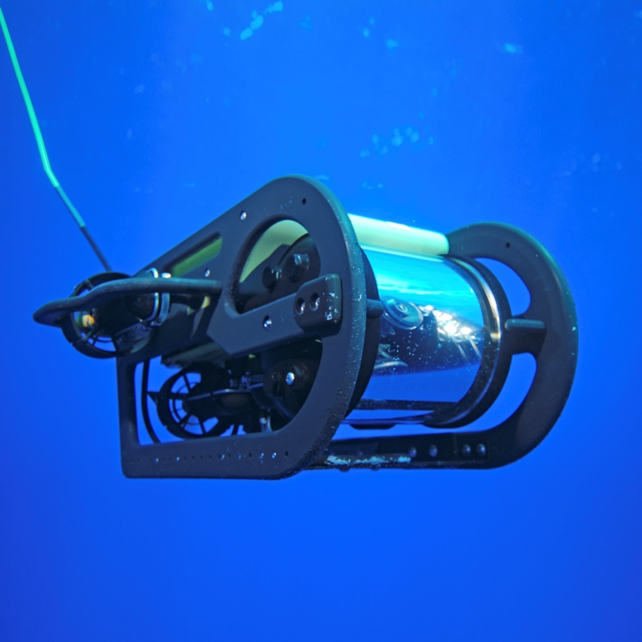
How can we get to videos and photos from the deepest ocean?
ROV’s: REMOTELY OPERATED VEHICLES

Slide 12
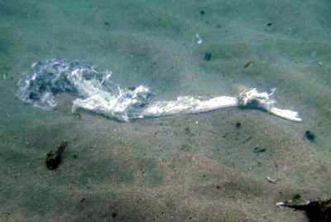
Life exists even in the ABYSS!
HOW?
CHEMICAL ENERGY ! (not solar energy)
hydrothermal vents, submarine hot springs, and methane seeps;
chemosynthetic organisms;
dead stuff.

Slide 13
hand-out vid notes…
Bill Nye Ocean Exploration…
https://www.youtube.com/watch?v=7yRbrGKVONg

