Slide 1
Protists obtain their energy in 3 ways
plant-like
2. Animal-like
3. Fungus-like
What are protists?
Why are protists considered the most diverse group of organisms?
Protists Notes
E152-E157
Define and give examples of algae, protozoa, and funguslike protists?
How can protists cause disease? Give an example of a disease and how it spreads? (Page E-156)
Draw, label, & color algae (Chlamydomonas)
Draw, label, & color Protozoa (Paramecium)

Slide 2
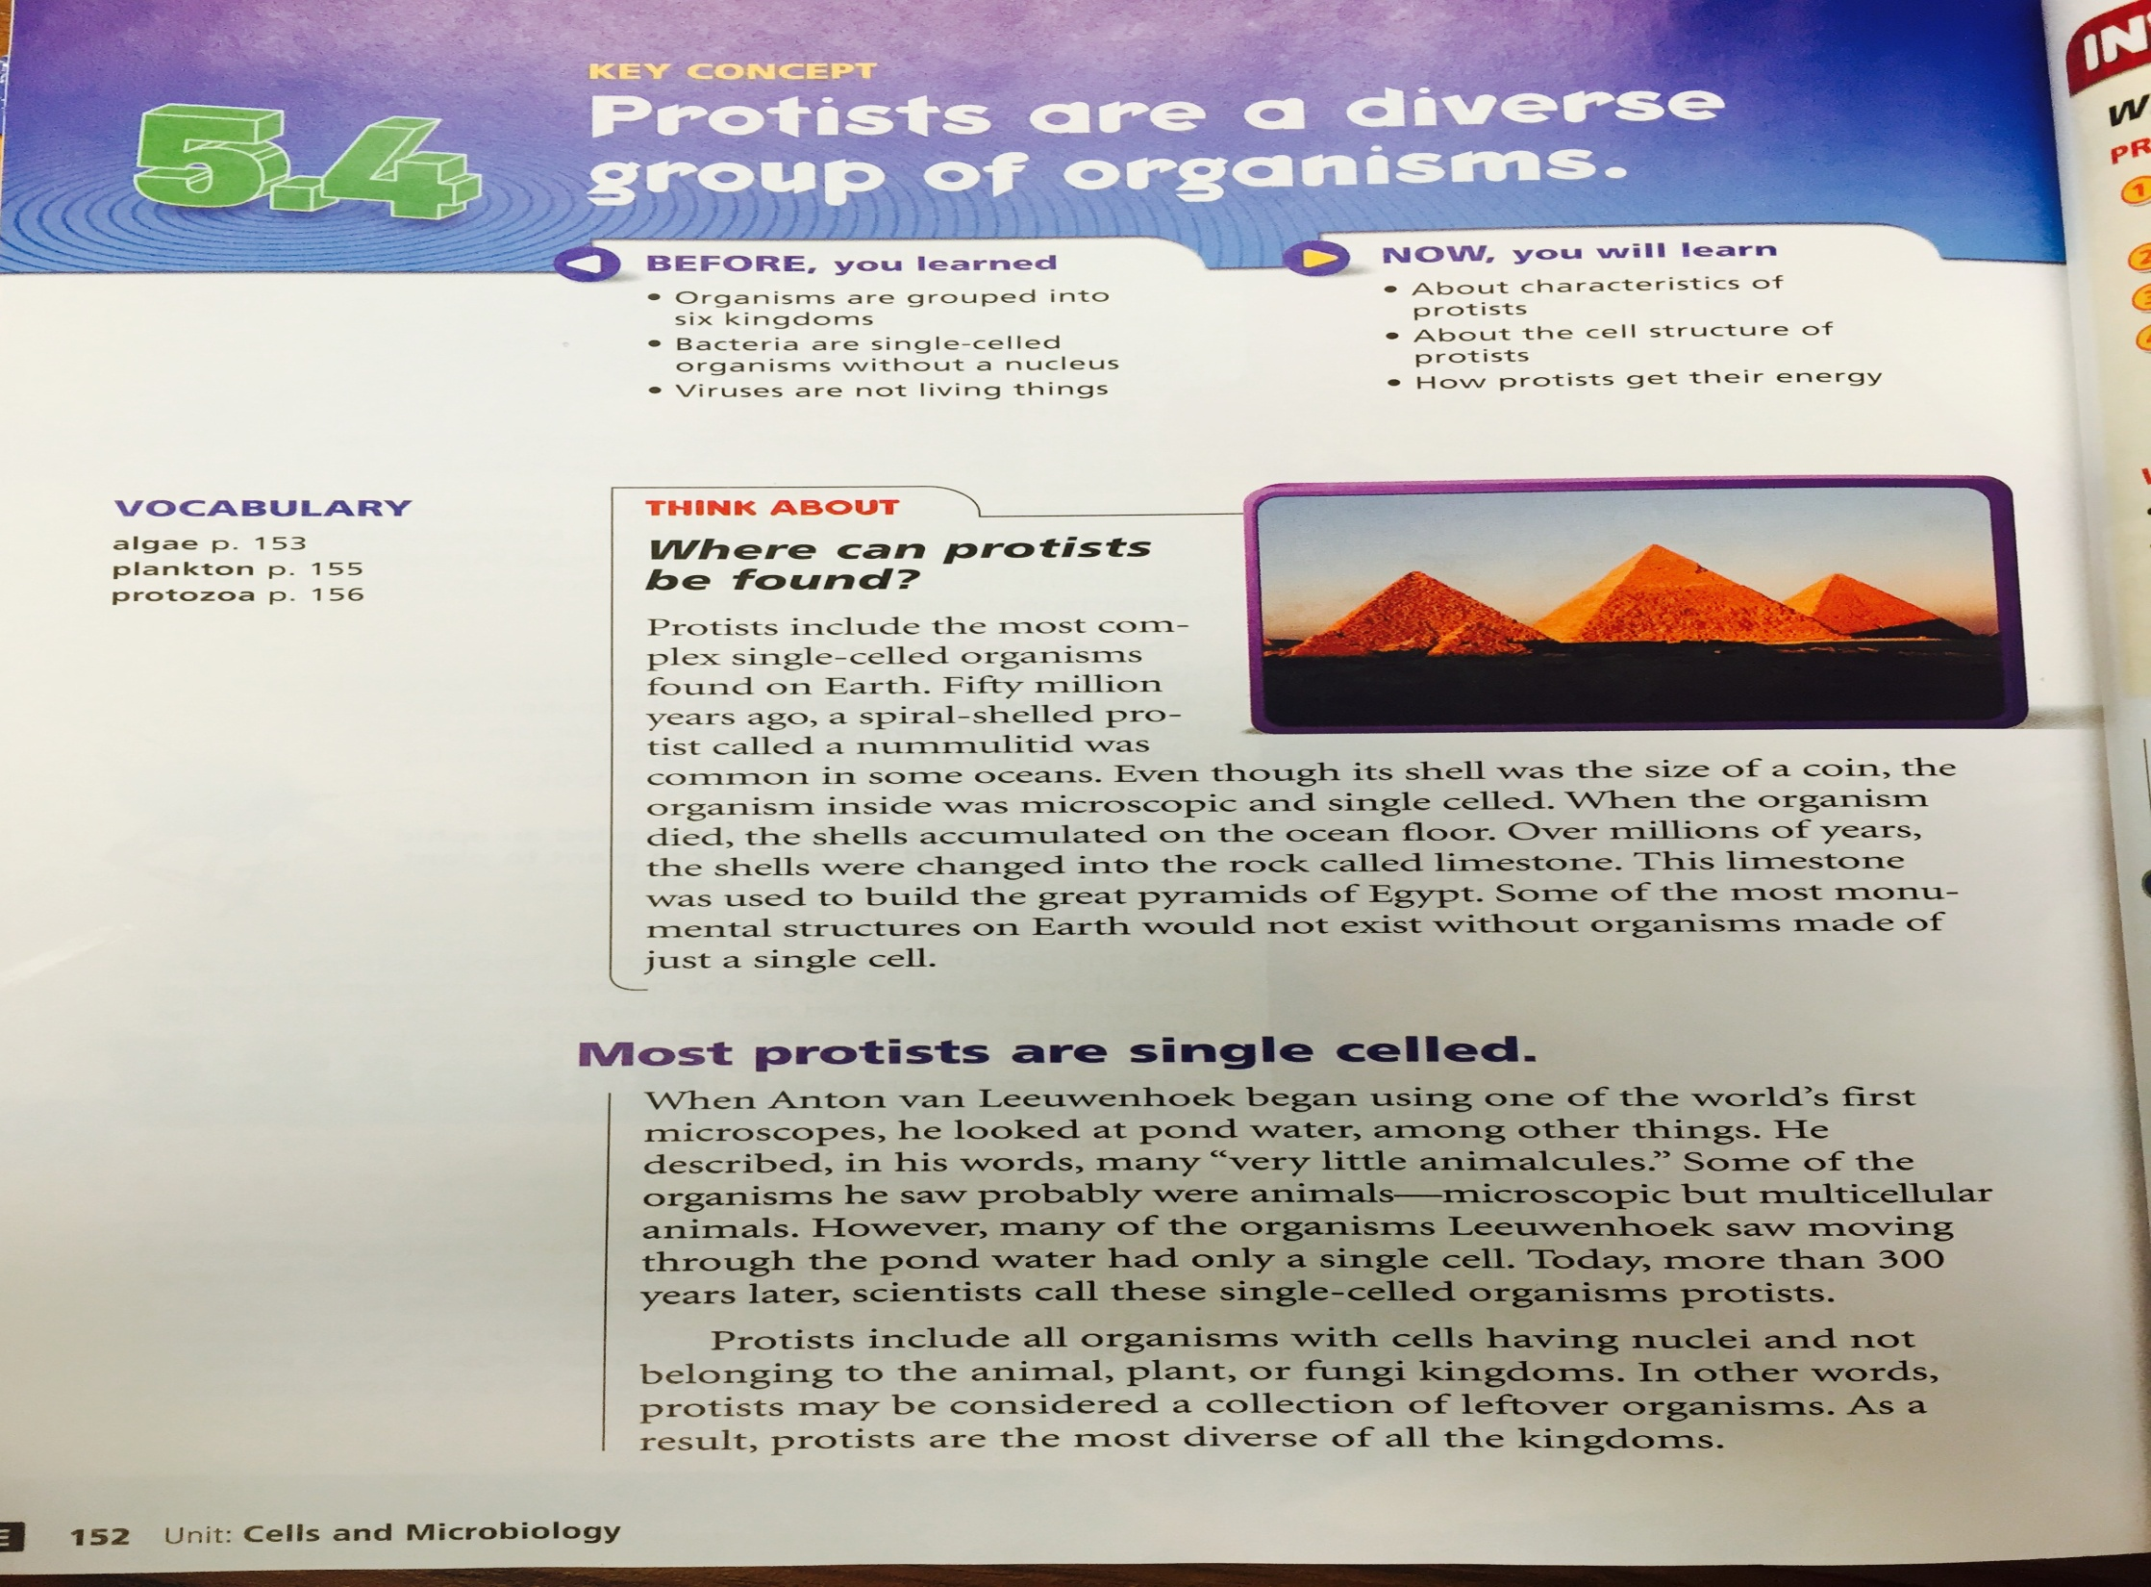

Slide 3
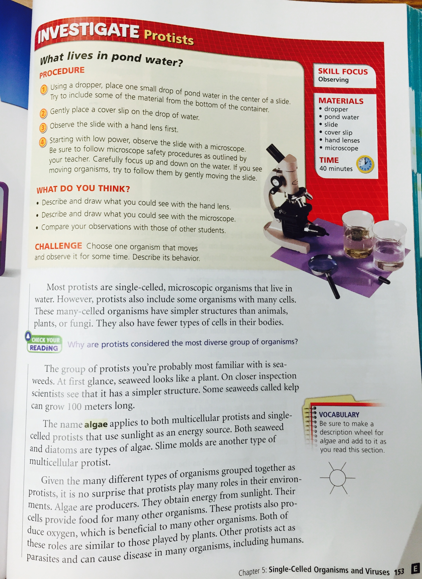

Slide 5
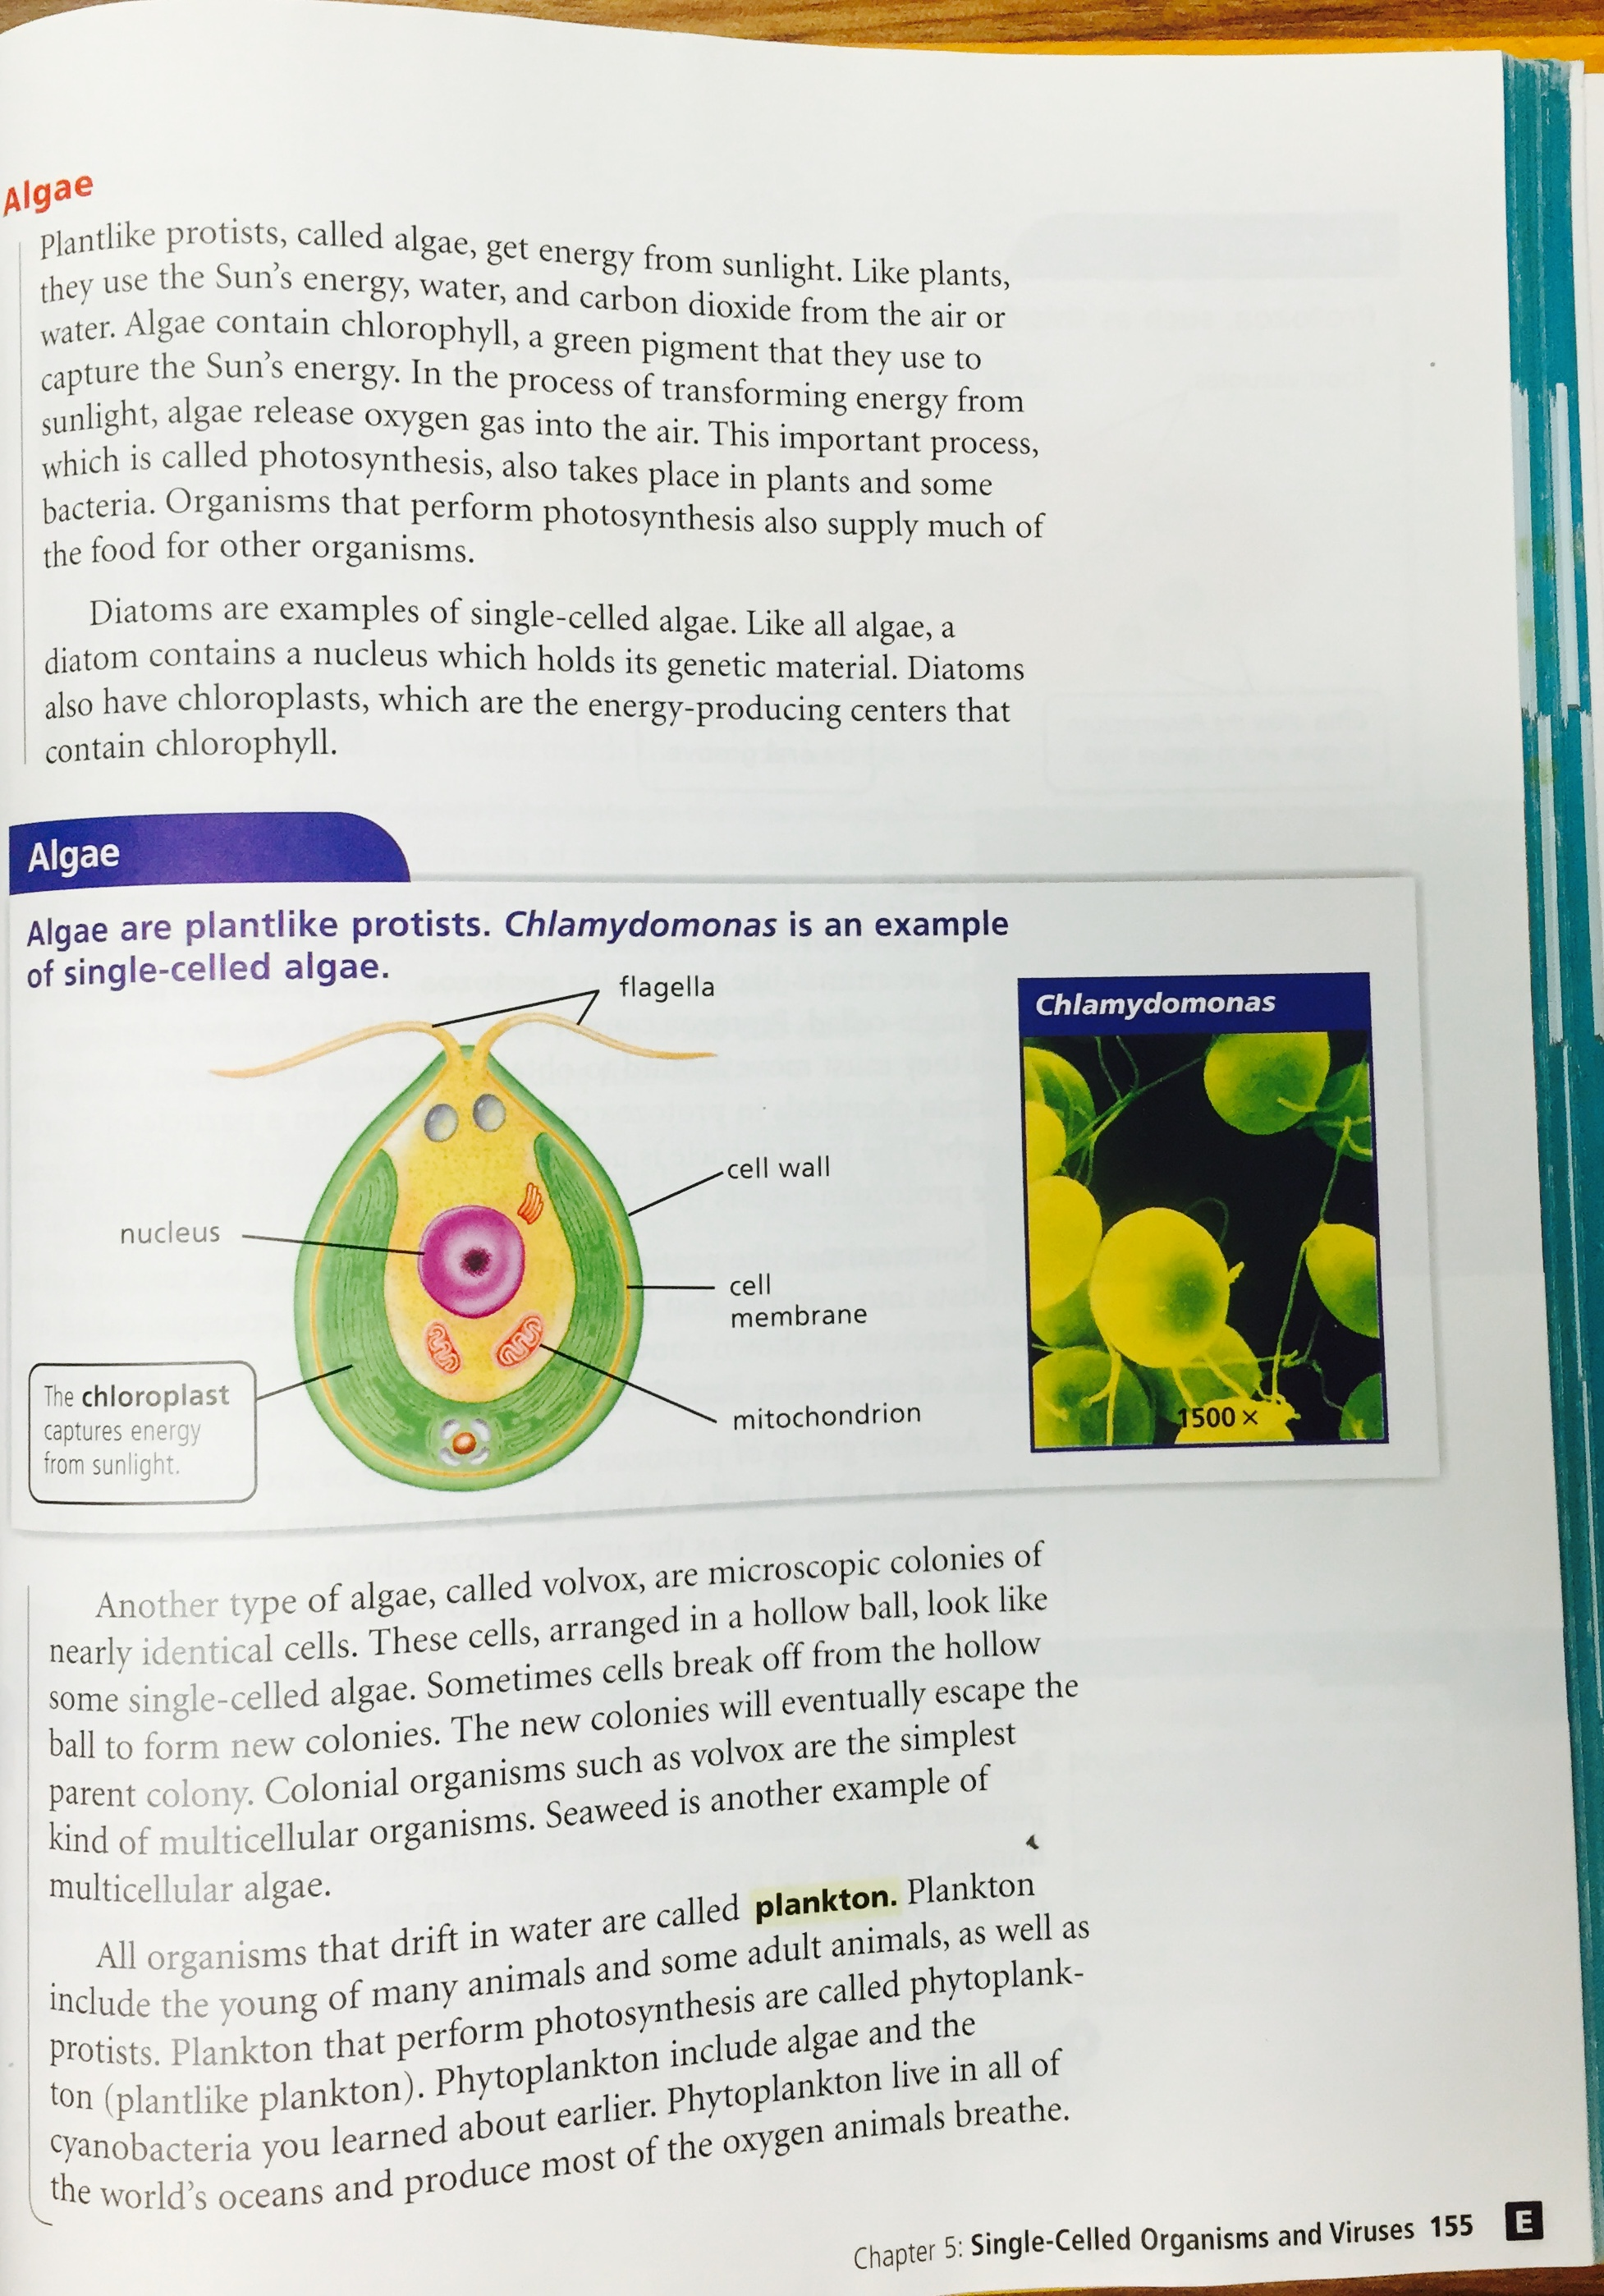

Slide 6
