Slide 1
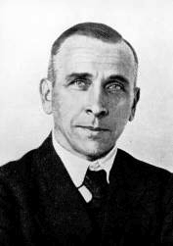
Draw Alfred Wegener
Explain how convection works
How does temperature in the earth help create cont. Drift?
What does density have to do with the composition of the Earth’s layers?
List and explain what scientist learned from drilling in the sea floor
Draw the Earth’s layers with convection currents
(Include Asthenosphere and Lithosphere)
Draw Wegener
List and describe 3 of Wegener’s Evidence of Continental Drift
Explain the theory of plate tectonics. This should be detailed

