Slide 1
Cell Theory and the Scientists Who Helped Shape It

Slide 2
The Cell
The smallest unit that can perform all life processes

Slide 3
Scientists and the Cell Theory

Slide 4
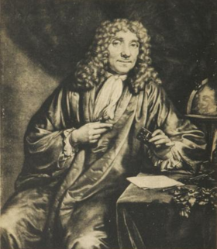
Anton van Leeuwenhoek
Born: October 24, 1632
Died: August 30, 1723
He is known as the “Father of Microscopy.”
http://en.wikipedia.org/wiki/Anton_van_Leeuwenhoek

Slide 5
Anton van Leeuwenhoek
Discoveries:
- 1673: He looked at pond scum under the microscope and discovered small organisms he called animalcules or little animals (Protists)
- 1676: discovered bacteria
http://www.kent.k12.wa.us/staff/TimLynch/sci_class/chap09/lesson_protista/Protista_Lesson.html#Algae

Slide 6
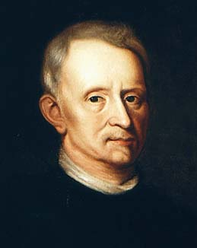
Robert Hooke
Born: July 18, 1635
Died: March 3, 1703
Wrote and published “Micrographia”
Known as the “English Father of Microscopy”
http://www-groups.dcs.st-and.ac.uk/~history/PictDisplay/Hooke.html

Slide 7
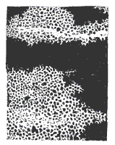
Robert Hooke
Contributions:
- He observed pieces of cork from the bark of a cork tree under the microscope.
- His observations led him to coin the word “cell.”
- “Cell”- means little rooms in Latin
- He compared the small boxes to the small rooms that monks lived in.
http://www.learner.org/channel/courses/essential/life/session1/closer1.html

Slide 8
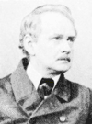
Matthias Schleiden
Born: April 5, 1804
Died: June 23, 1881
German botanist
Discovered that all plants were made of cells
Contributed to the creation of the cell theory
http://www.britannica.com/eb/article-9066147/Mathias-Jacob-Schleiden

Slide 9
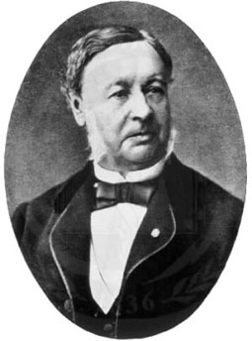
Theodor Schwann
Born: December 7, 1810
Died: January 11, 1882
German zoologist
Concluded that all animals are made of cells.
Contributed to the creation of the cell theory
http://www.nndb.com/people/357/000096069/

Slide 10
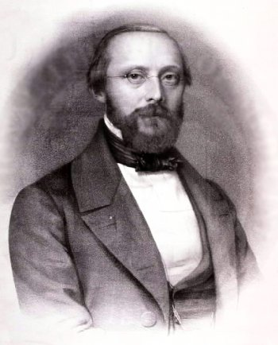
Rudolph Virchow
Born: October 13, 1821
Died: September 5, 1902
German pathologist
He is known as the
“Father of Pathology.”
Discovered that all living cells come only from other living cells.
http://en.wikipedia.org/wiki/Image:Rudolf_Virchow.jpg

Slide 11
The Cell Theory
Major Contributors:
Matthias Schleiden
Theodor Schwann
Rudolph Virchow

Slide 12
The Cell Theory
All living things are made of cells.
Cells are the basic units of structure and function in living things.
Living cells come only from other living cells.

Slide 13
Bill Nye Video-Cell Theory

